Slide 1
Making the Case for Dental Coverage for Adults in All State Medicaid Programs

Slide 2
Making the Case for Dental Coverage for Adults in All State Medicaid Programs

Slide 3
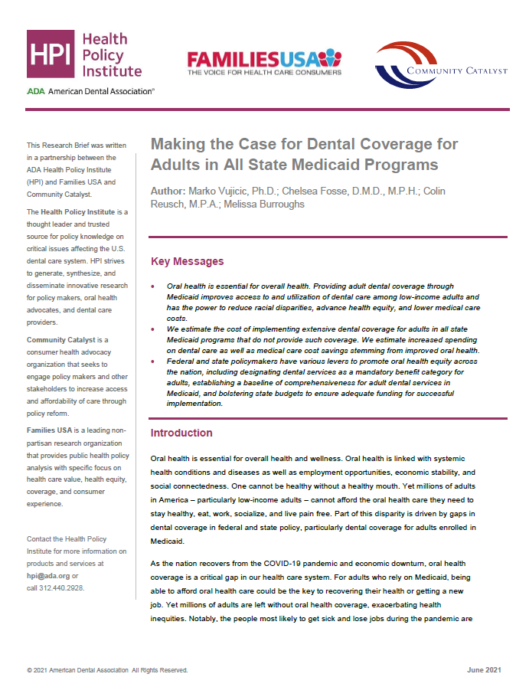
Today We are Launching a New Report
View report at: ADA.org/hpi

Slide 4
Why This Report and Why Now?
Review the evidence on barriers to dental care for low-income adults
Review the evidence linking comprehensive dental coverage for adults and improved oral health, reduced medical care spending, and economic benefits
Summarize the current landscape of dental coverage for adults in state Medicaid programs
Estimate the fiscal impact of providing comprehensive dental coverage for adults in all state Medicaid programs
Discuss policy options

Slide 5
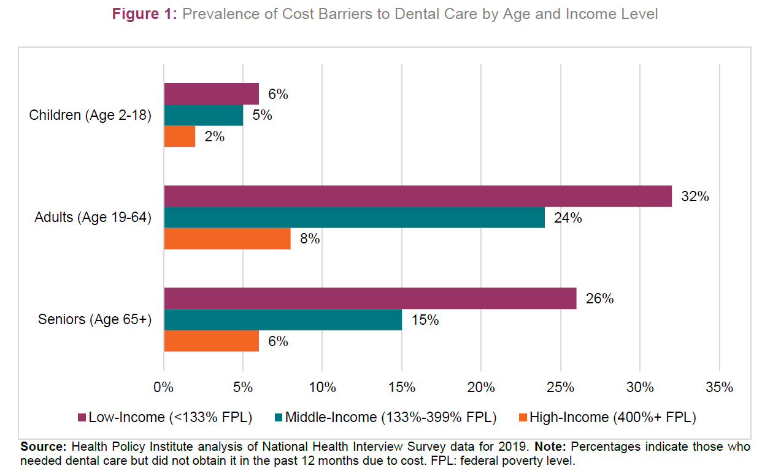
Barriers to Dental Care
The most commonly cited barriers to accessing needed dental care all relate to cost.
Cost barriers to dental care are higher than for any other type of health care service.
Of any age and income group, low-income adults face the most significant cost barriers to dental care.

Slide 6
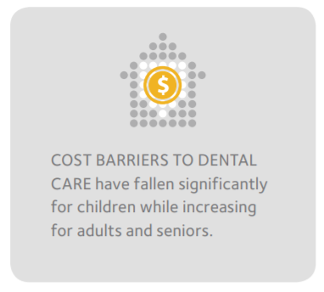
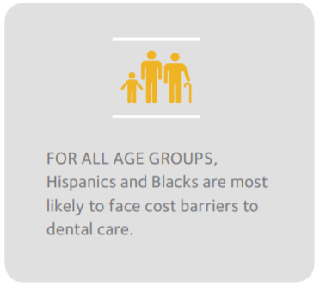
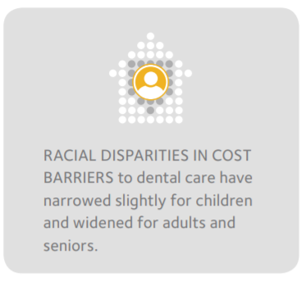
Barriers to Dental Care

Slide 7
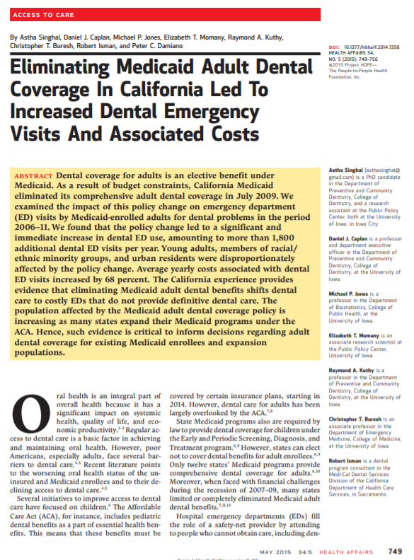
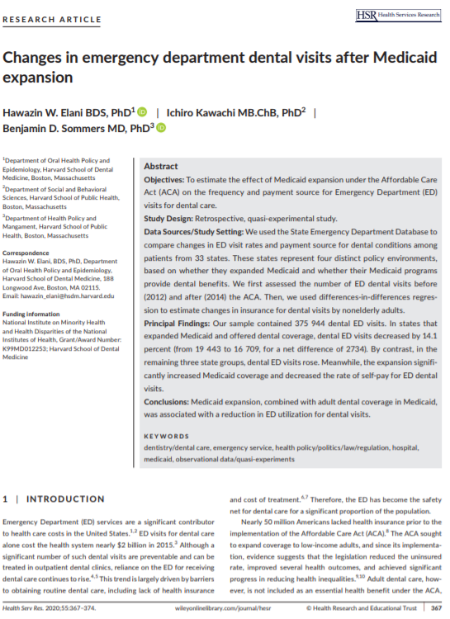
Impact of Medicaid Dental Coverage
Providing adult dental coverage in Medicaid significantly reduces emergency department visits and spending for dental conditions.
These cost savings are realized by diverting care from hospital emergency departments to more cost-effective settings like a dental office or community health center.

Slide 8
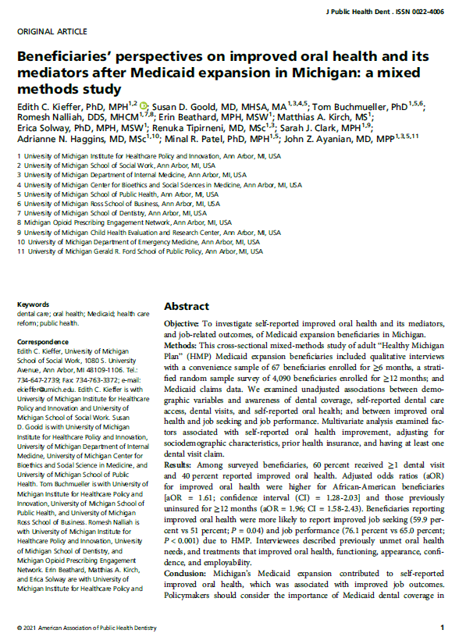
Impact of Medicaid Dental Coverage
When adults gain extensive dental coverage through Medicaid, their job prospects improve. The impact is largest for Black Medicaid enrollees.

Slide 9
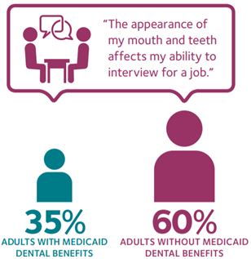
Impact of Medicaid Dental Coverage
Low-income adults living in states where the Medicaid program provides comprehensive dental coverage are far less likely to experience negative economic consequences stemming from poor oral health.

Slide 10
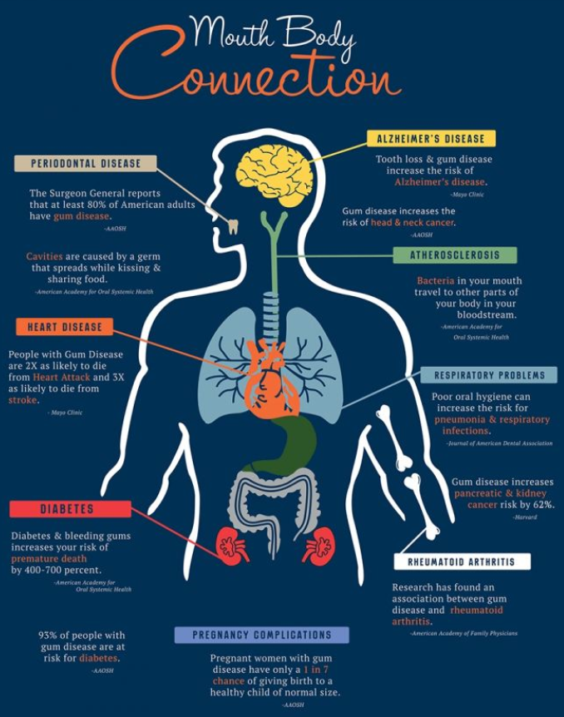
Impact of Medicaid Dental Coverage
Increased access to dental care is associated with lower medical care costs among patients with certain conditions such as diabetes.

Slide 11
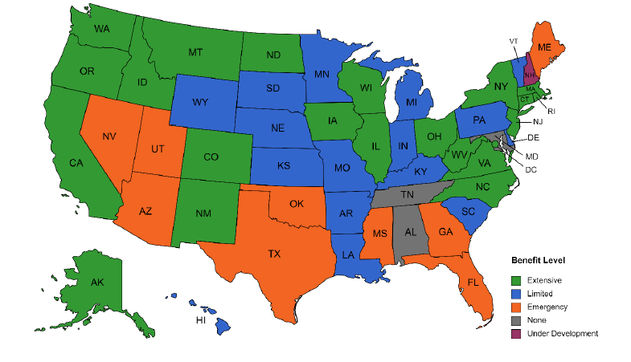
The Current Landscape
As of early 2021…
21 states provide extensive adult dental benefits in their Medicaid programs.
16 states provide limited benefits,
9 provide emergency-only benefits,
3 provide no benefits, and
1 has a dental benefit under development.

Slide 12
What Would it Cost to Provide Extensive Dental Coverage?
We estimated the fiscal impact of adding extensive dental coverage for adults in the 28 state Medicaid programs that do not provide it.
We estimated the increased dental care costs as well as reductions in medical care costs among beneficiaries with diabetes, heart disease, and who become pregnant. We did not estimate emergency room cost savings due to data constraints.
We estimated the federal and state shares of spending according to current FMAP rates.
We summarize results for all 28 states combined as well as state by state.

Slide 13
What Would it Cost to Provide Extensive Dental Coverage?
We leveraged newly available Medicaid claims data for all states to calculate current dental care use rates and spending levels for Medicaid beneficiaries. This allowed for much more accurate predictive analysis.

Slide 14
What Would it Cost to Provide Extensive Dental Coverage?
It important to note that our analysis likely overestimates net costs. We were conservative in our assumptions and we also do not include emergency room cost reductions in our analysis.

Slide 15
Moving from Optional to Essential
Make comprehensive adult oral health coverage a permanent part of the Medicaid program for all states. Congress could designate dental services as a mandatory benefit category for all Medicaid-enrolled adults.
Congress could consider policy aimed at establishing a baseline of comprehensiveness for adult dental services in Medicaid. Policymakers can amend the current statutory definition of Medicaid dental services to address the full range of oral health conditions, specifying categories of services as necessary.
Congress could consider increasing the FMAP for states to support comprehensive oral health coverage. Adequate funding of state Medicaid programs is necessary for the successful implementation of a new benefit.
Ensure that fiscal estimates (or CBO scoring) properly account for potential medical care cost reductions, including reduced emergency room spending, associated with expanded dental coverage for adults in Medicaid programs.

