Slide 1
How Did the COVID-19 Pandemic Affect Dentist Earnings? September 2, 2021

Slide 2
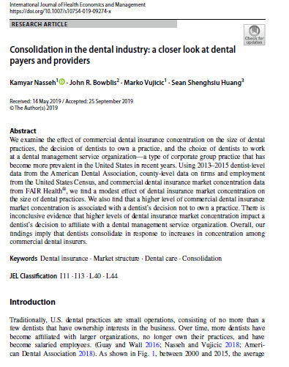
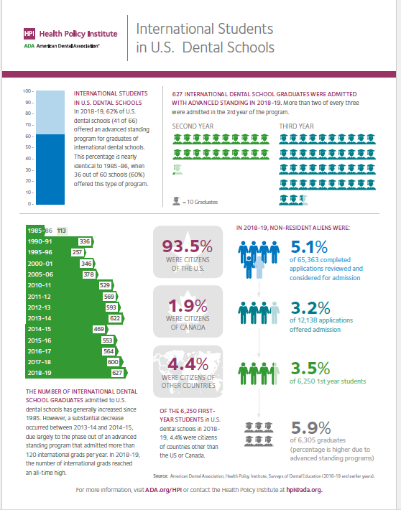
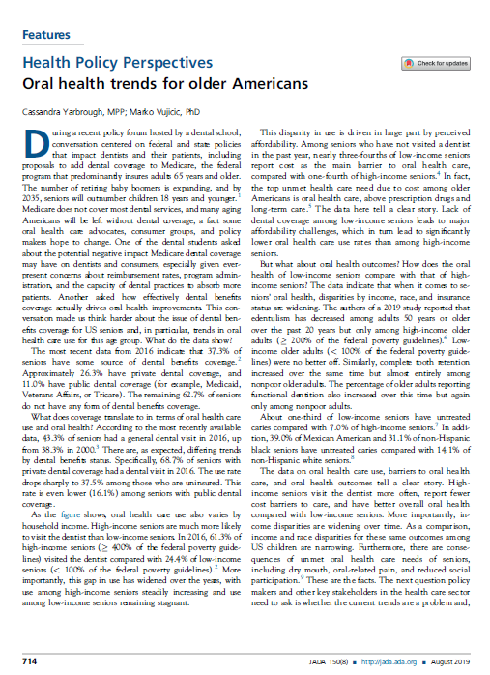
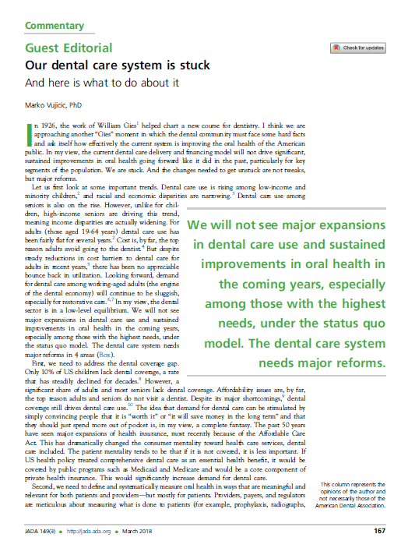
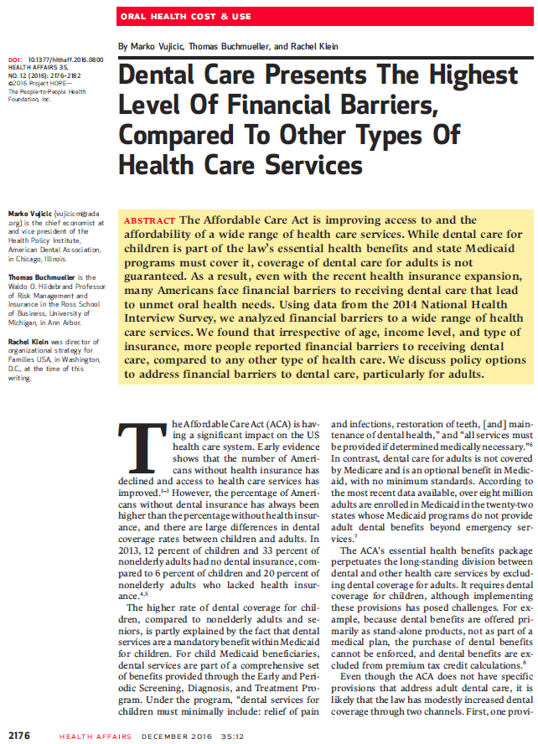
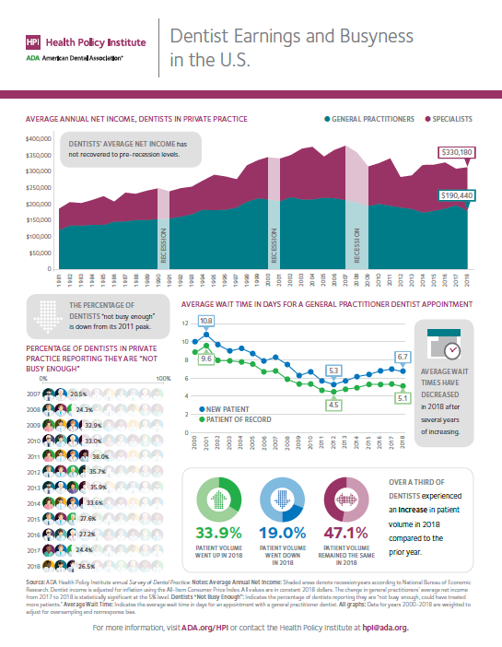
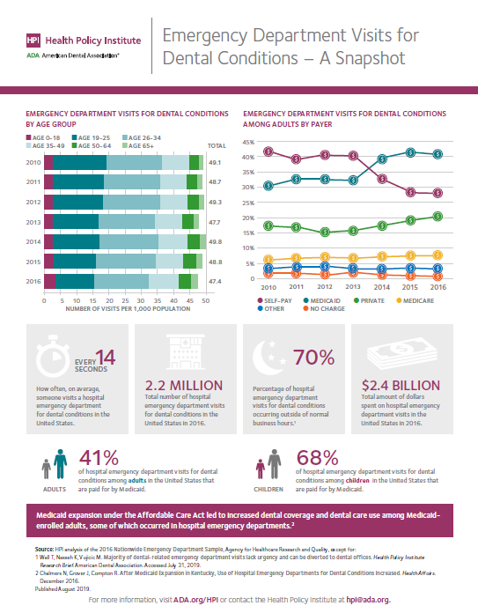
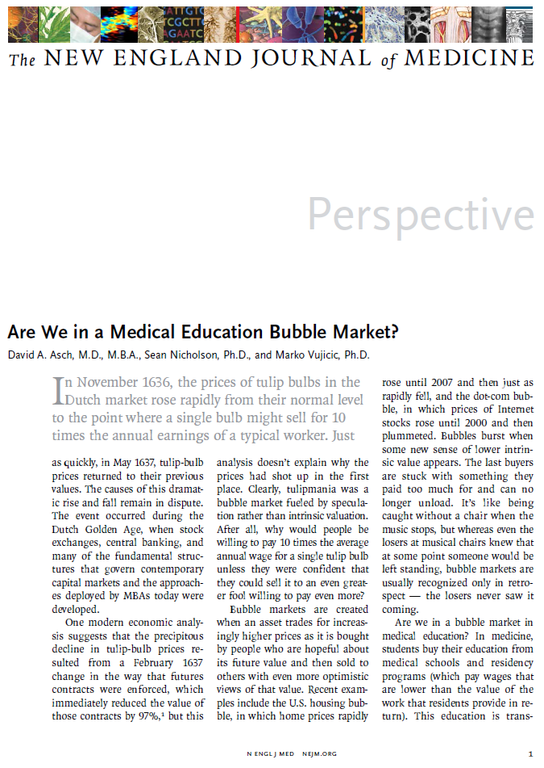
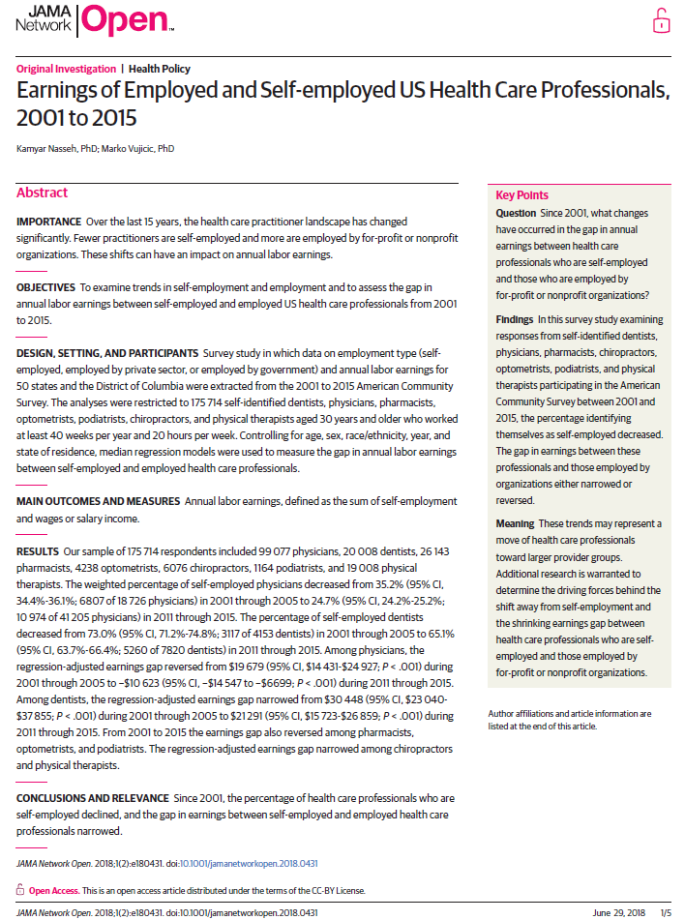
HPI – Rigorous Research

Slide 3
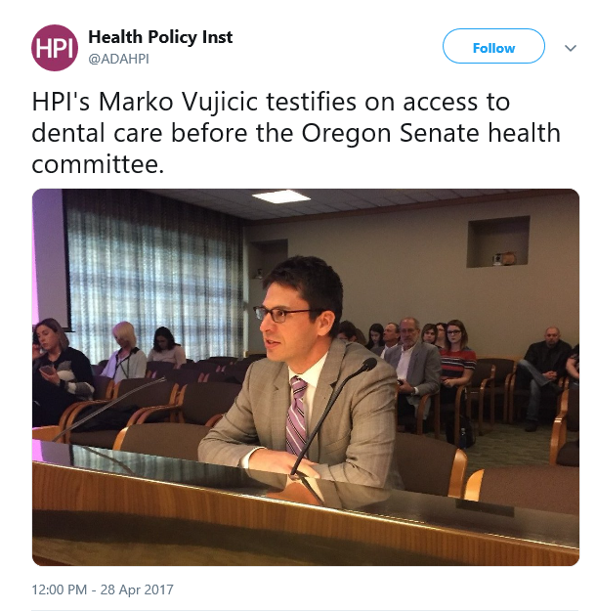
HPI – Evidence for Policy Making

Slide 4
HPI – Insights for your Business

Slide 5
Today
Latest on dentistry’s COVID-19 recovery
New report – impact of COVID-19 on dentist net income

Slide 6
Patient Volume
*
Patient volume reached its highest level during the week of August 16th, at 89% of pre-COVID-19 levels.
*Note that HPI changed its response options, allowing dentists to report greater patient volumes compared to pre-pandemic levels. This did not have a big impact on results.
Notes:
The change in response options seems to have had a greater effect on how patient volume in public health settings is reflected.
More than 1 in 4 health center dentists indicated they have greater patient volumes compared to before the pandemic.

Slide 7
Recruitment and Hiring
[Owner dentists only] Have you recently or are you currently recruiting any of the following positions in your dental practice?
Owner dentists have increased recruitment efforts for all dental team members.
About four in 10 have recently or are currently seeking dental assistants, and roughly one-third have recently or are currently hiring dental hygienists.
Notes:
More recruitment in DSOs, group practices, younger age groups (under 35, 35 to 44)

Slide 8
Major Challenges Filling Positions
[If recruiting] Compared to before the COVID-19 pandemic, how challenging has it been to recruit the position(s) below? (Percentages indicating “extremely” or “very” challenging.)
Dentists are facing major challenges in recruiting dental team members.

Slide 9
Shortages Limiting Patient Volume
Staffing shortages are the most common limiting factor for practices that want to see more patients, followed by safety protocols and low patient demand.
Notes:
Presented to owner dentists only, regardless of reported patient volume
Select all that apply.
OPS: Not enough staff, not enough operatories, cancellations due to COVID exposure/illness, late cancellations and no shows
DSOs, group practices – more report trouble filling vacant positions

Slide 10
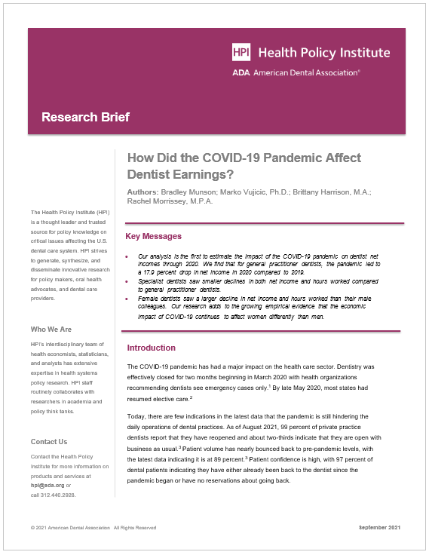
New Report Launched Today
www.ada.org/hpi

Slide 11
Key Findings
General practitioner income down 17.9% in 2020 compared to 2019
Specialist dentists saw smaller decreases in income and hours worked than general practitioners
Female general practitioners saw much larger decreases in income and hours worked than male colleagues

Slide 12
Data and Methods
Data from HPI Survey of Dental Practice
An annual survey of dentists in private practice including ADA members, non-members, DSO dentists, old/young, male/female etc.
Data collection completed in June 2021
Net income is defined as for “you only” and is income left over after practice expenses and business taxes and includes salary, commission, bonus, practice distributions, dividends, and any payments made to a retirement plan on the dentist’s behalf
Results are weighted to compensate for nonresponse bias and to adjust results to be representative

Slide 13
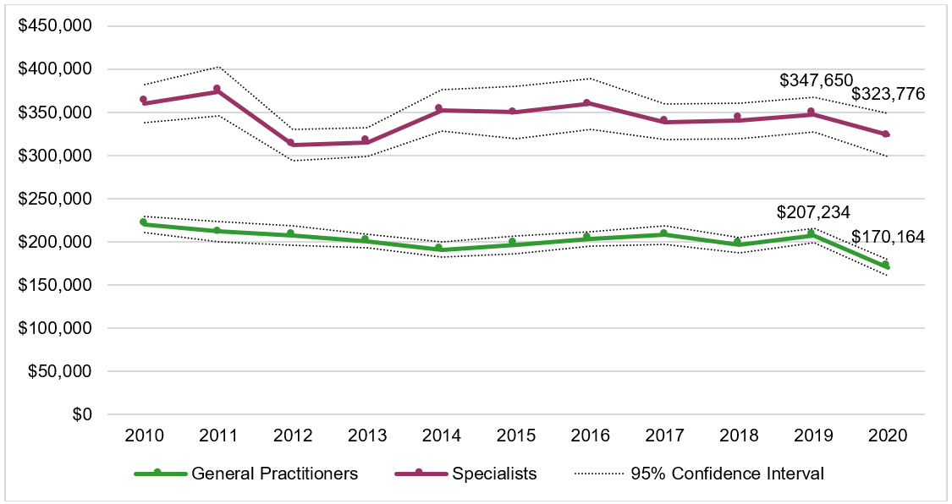
Average Net Income (Inflation-Adjusted)
In 2020 net income declined by 17.9% for general practitioners and 6.9% for specialists.

Slide 14
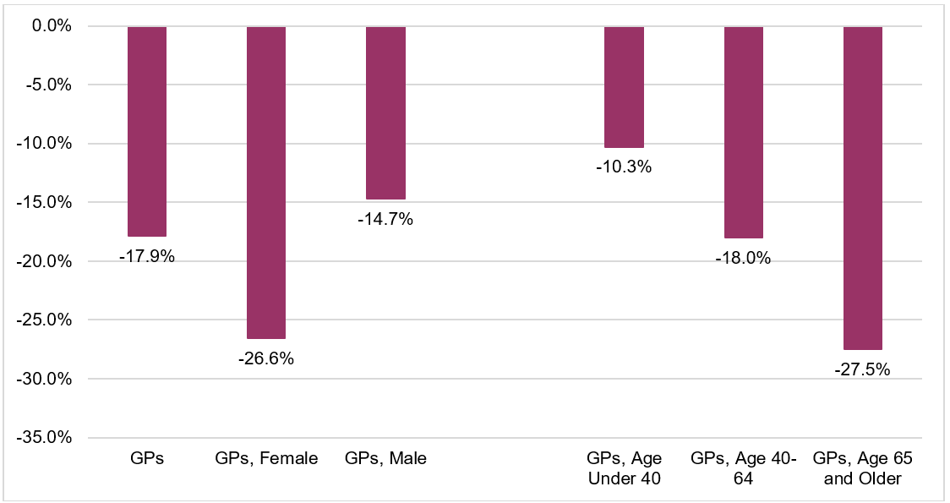
Change in GP Average Net Income, 2019-2020
In 2020 net income declined by 26.6% for female general practitioners and 14.7% for male general practitioners.
Net income declined by 27.5% for older GPs and 10.3% for GPs younger than 40.

Slide 15
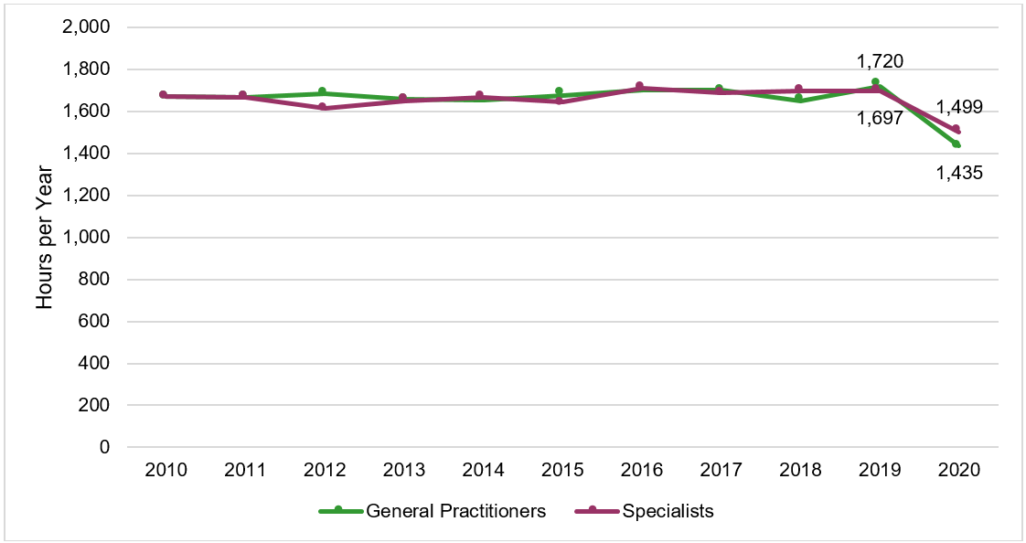
Average Hours Worked
In 2020, hours worked declined by 16.6% for general practitioners and 11.7% for specialists.

Slide 16
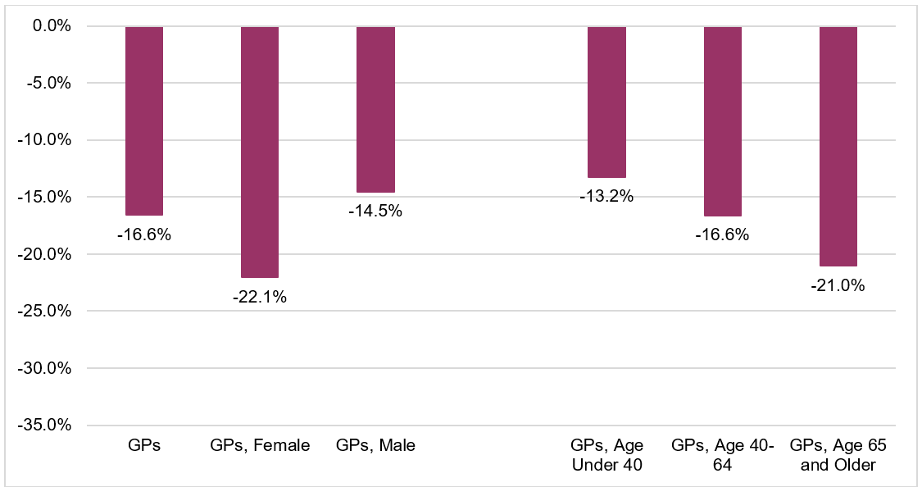
Change in GP Average Hours Worked, 2019-2020
In 2020 hours worked declined by 22.1% for female general practitioners and 14.5% for male general practitioners.
Hours worked per year declined by 21.0% for older GPs and 13.2% for GPs younger than 40.

Slide 17
Dentists’ Hours and Weeks Worked, 2020
In 2020 both general practitioners and specialists were open for ‘emergencies only’ for about 7 weeks.
During that period they averaged between 11 and 12 hours per week in the practice.

Slide 18
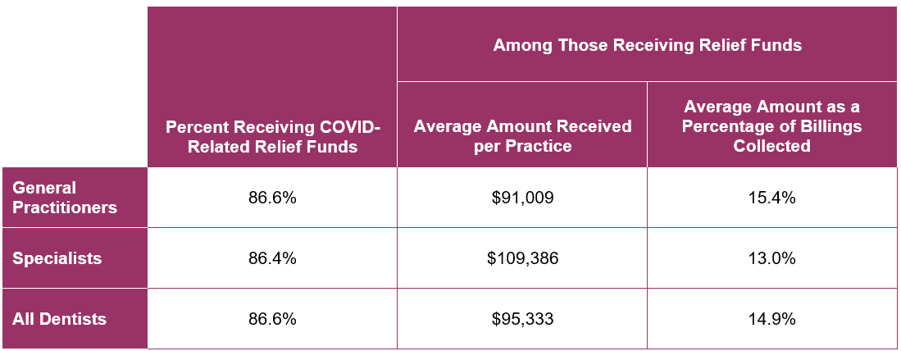
COVID-19 Related Relief Funds, 2020
In 2020 dentists received an average of $95,000 per practice in COVID-19 related relief funds.
This amount was separate from billings collected but equivalent to 15% of billings collected from dental care provision.

Slide 19
Thank you!
@ADAHPI
ADA.org/HPI
ADA.org/HPIConsulting
hpi@ada.org

