Slide 1
How Big are Dental Service Organizations?
Thank you for joining! You will be on hold until the call begins at 11:30 a.m. Central time
Please remember to mute your phone unless you are speaking.
This webinar will be recorded.
Streaming audio is available through your computer
If you’d like to call in to listen to the audio via phone, dial (888) 299-7210 and enter conference ID: 814413

Slide 2
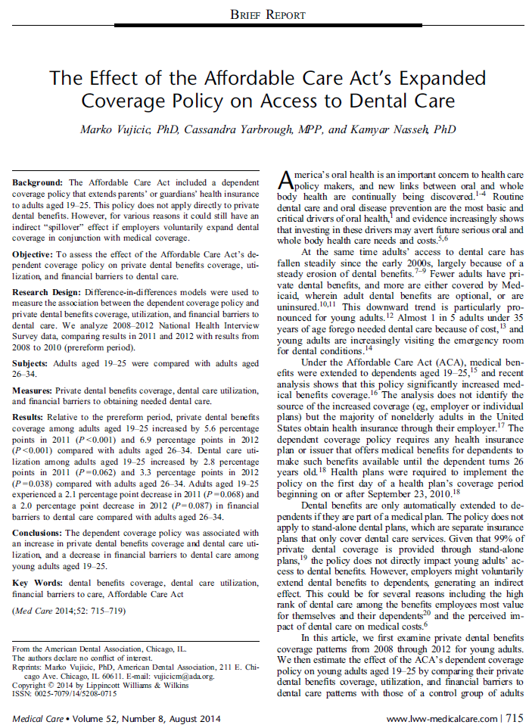
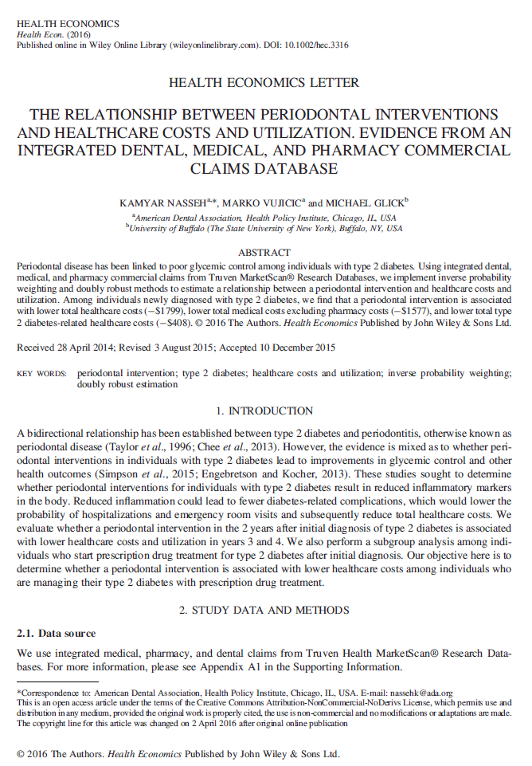
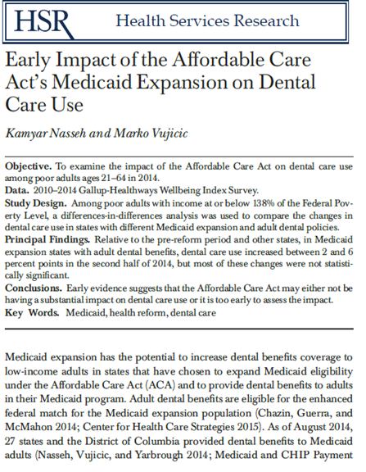
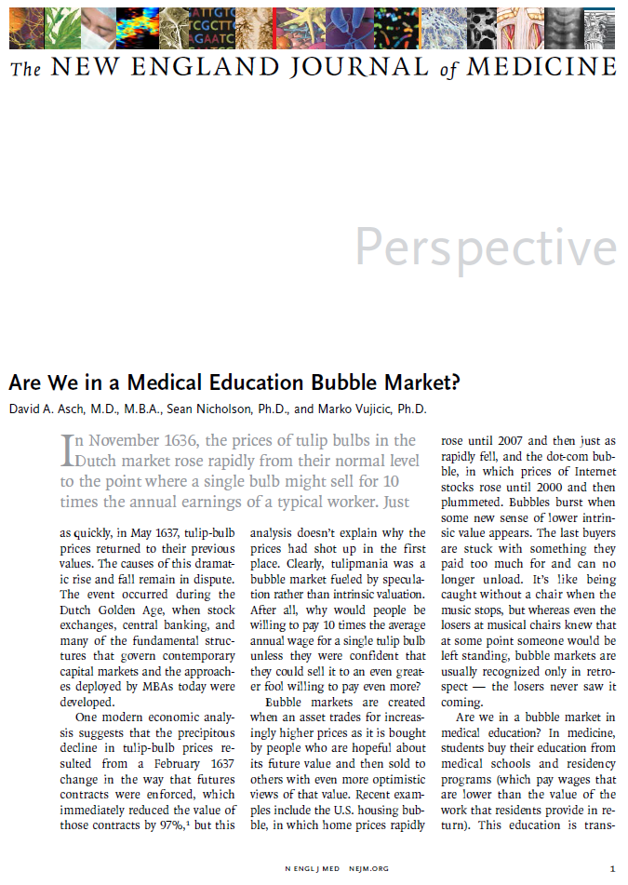
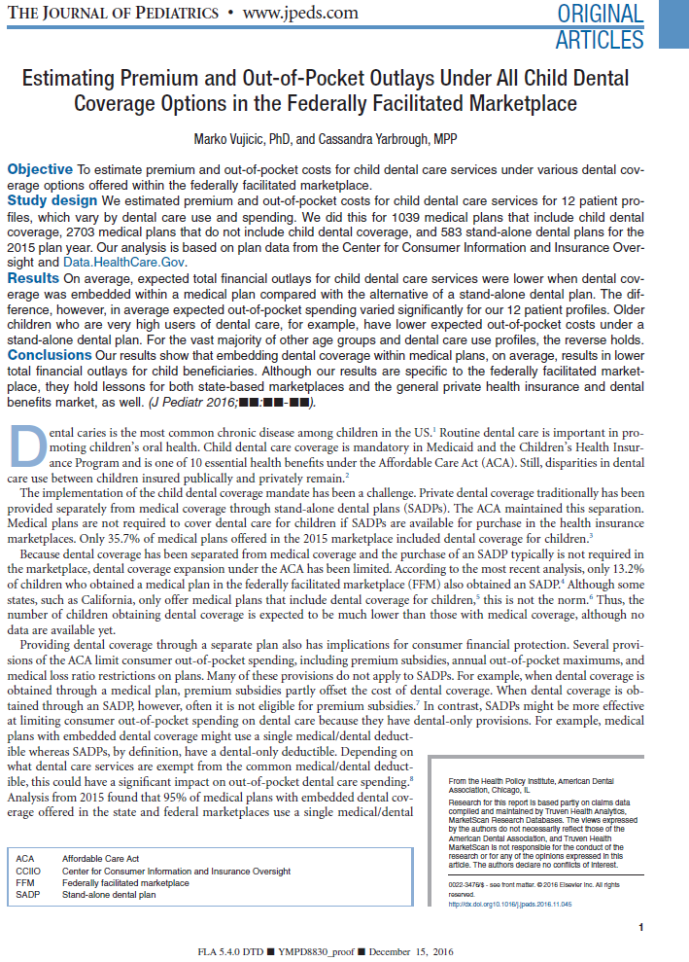
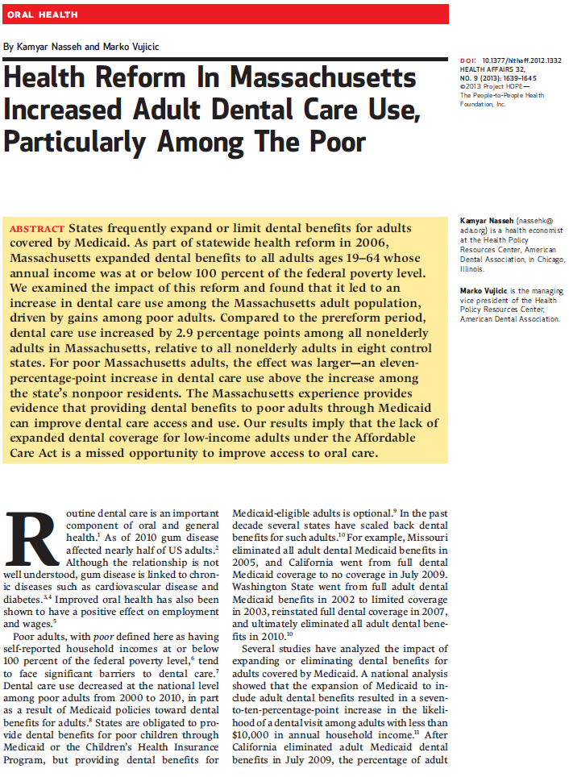
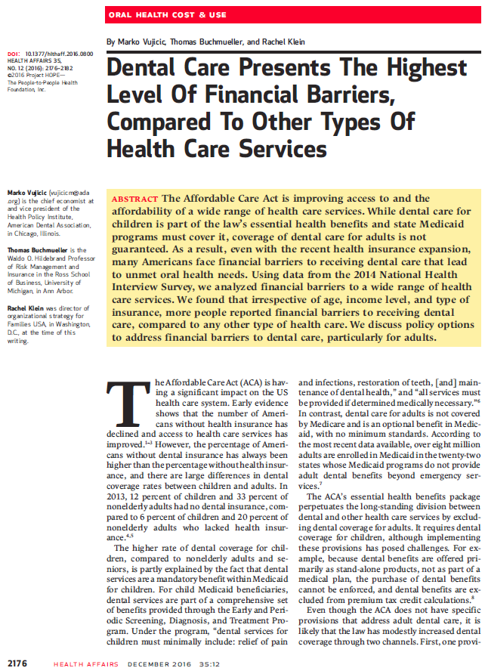
The ADA Health Policy Institute

Slide 3

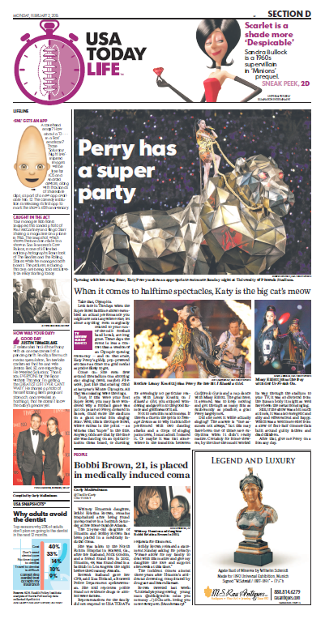
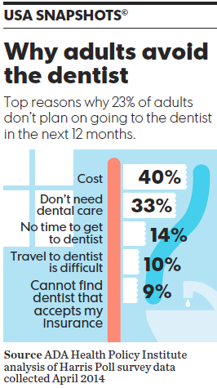


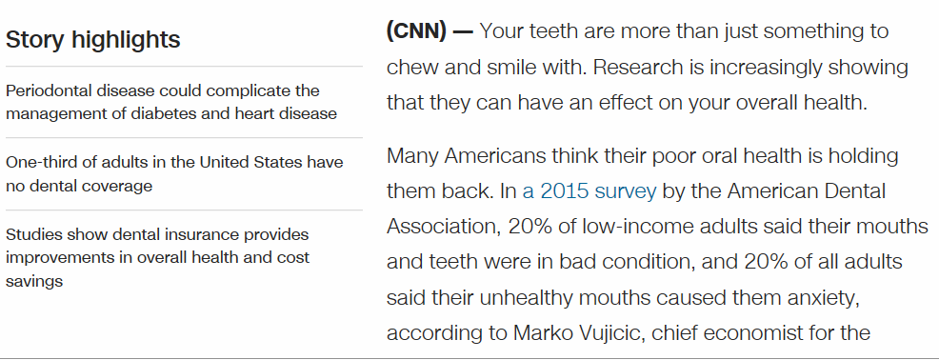

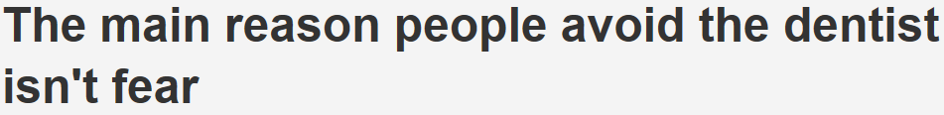
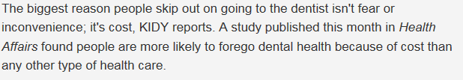
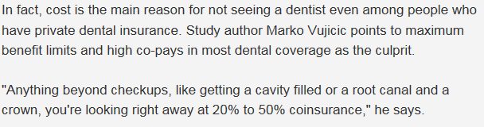
The ADA Health Policy Institute

Slide 4
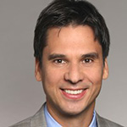
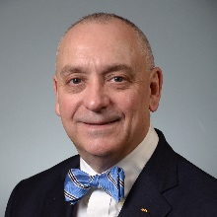
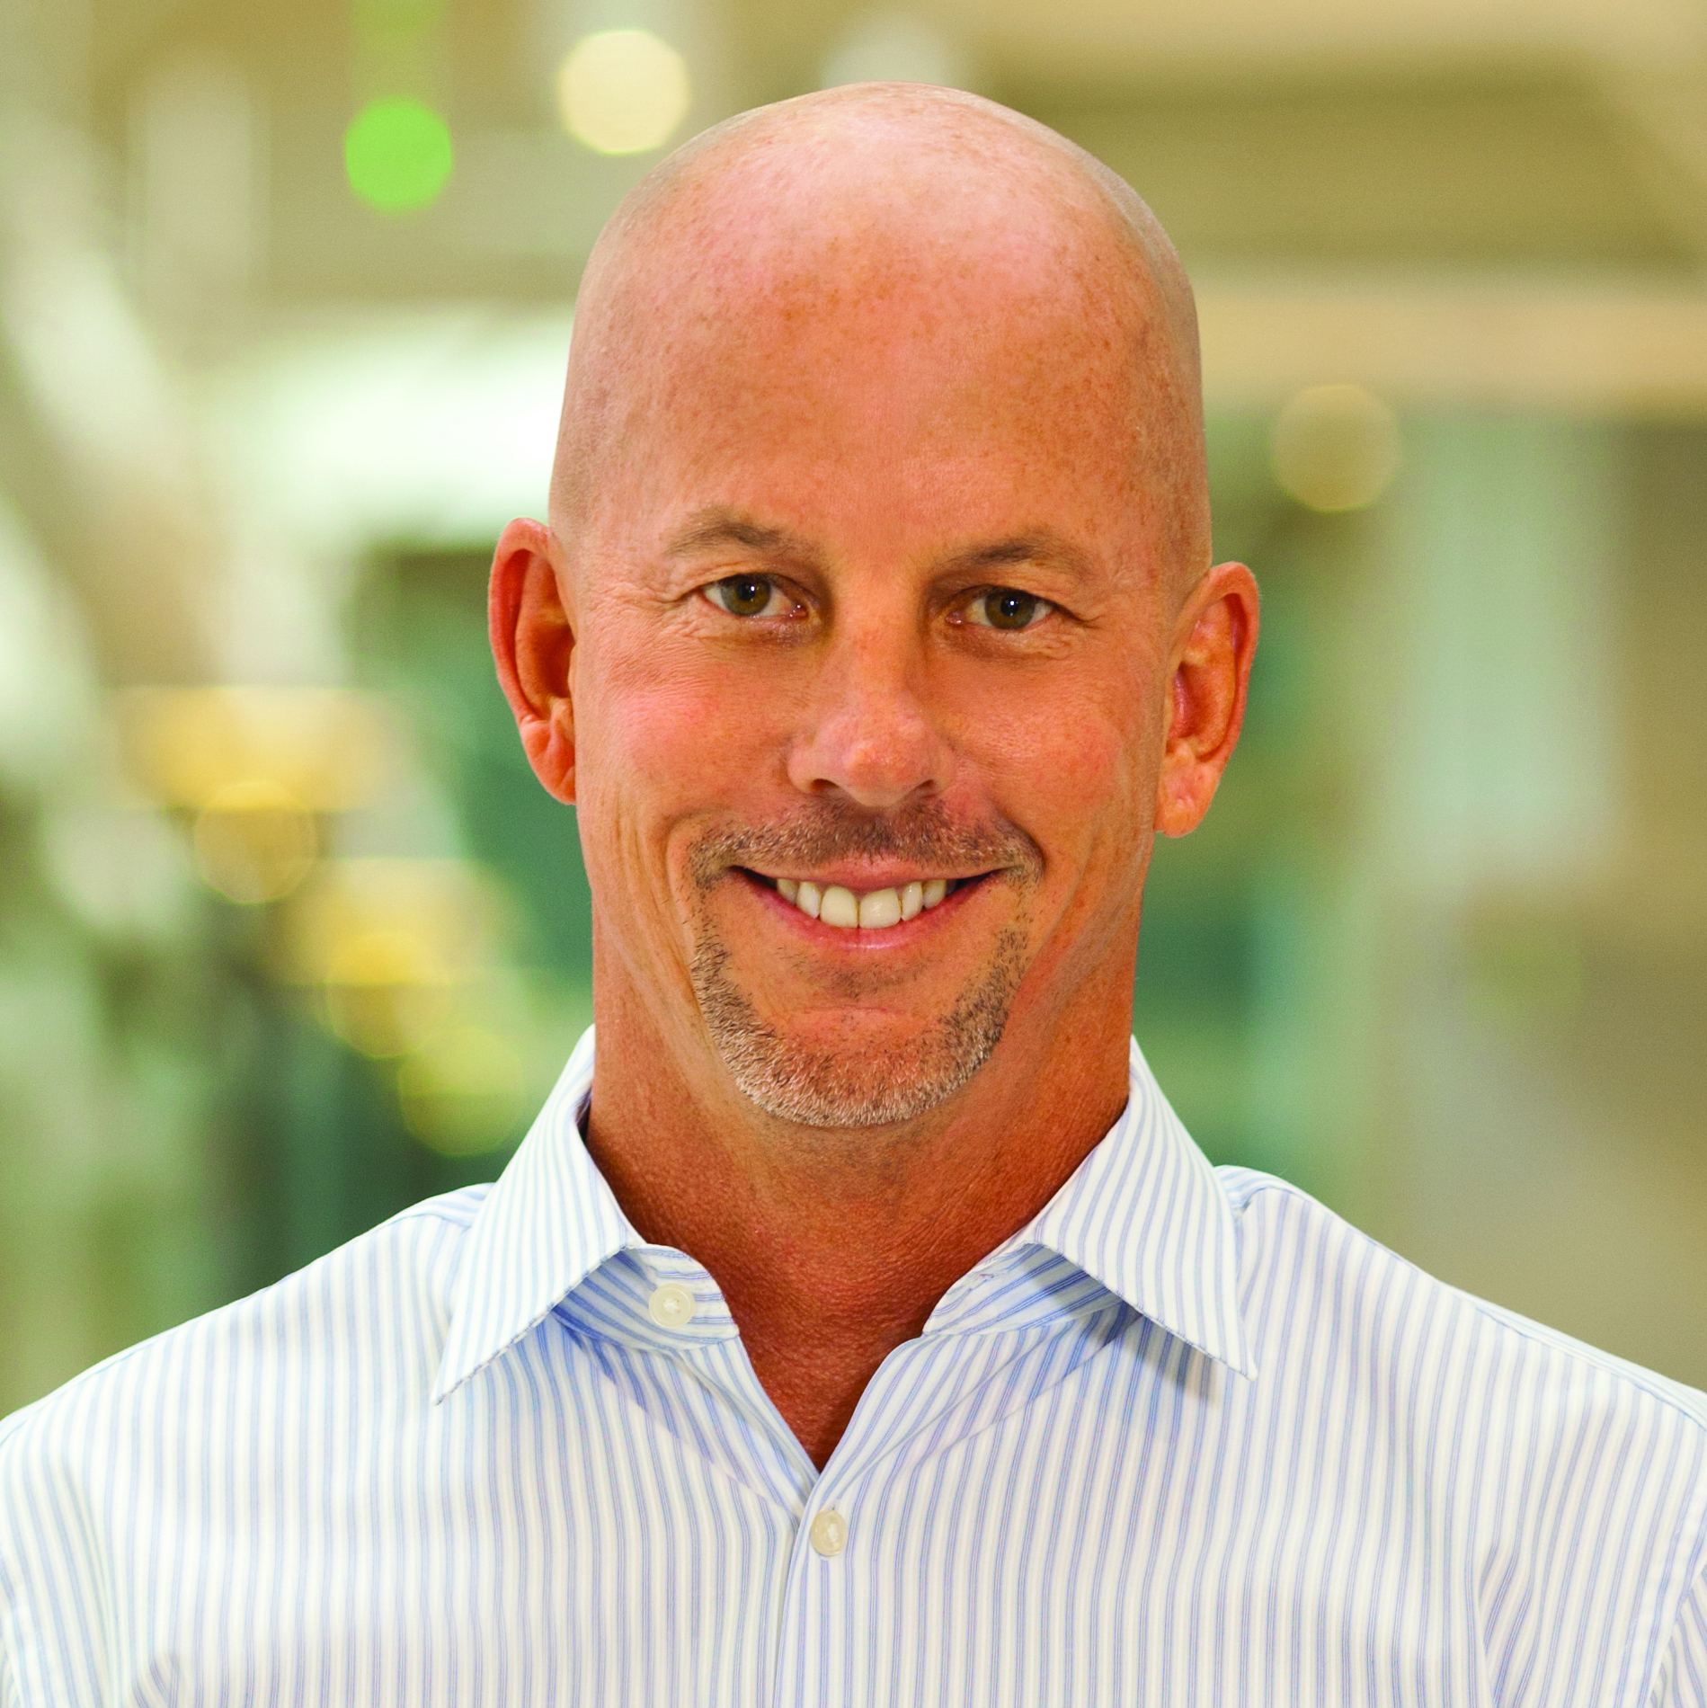
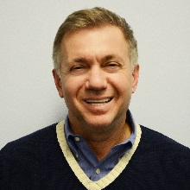
Today
CHAIR
Marko Vujicic, Chief Economist & Vice President, ADA Health Policy Institute
PANELISTS
Dave Preble, DDS, JD, Vice President, Practice Institute
Stephen E. Thorne IV, MHA, Founder, President & CEO, Pacific
Dental Services
Dmitry Edelchik, MBA, Director of Marketing, Planmeca USA

Slide 5


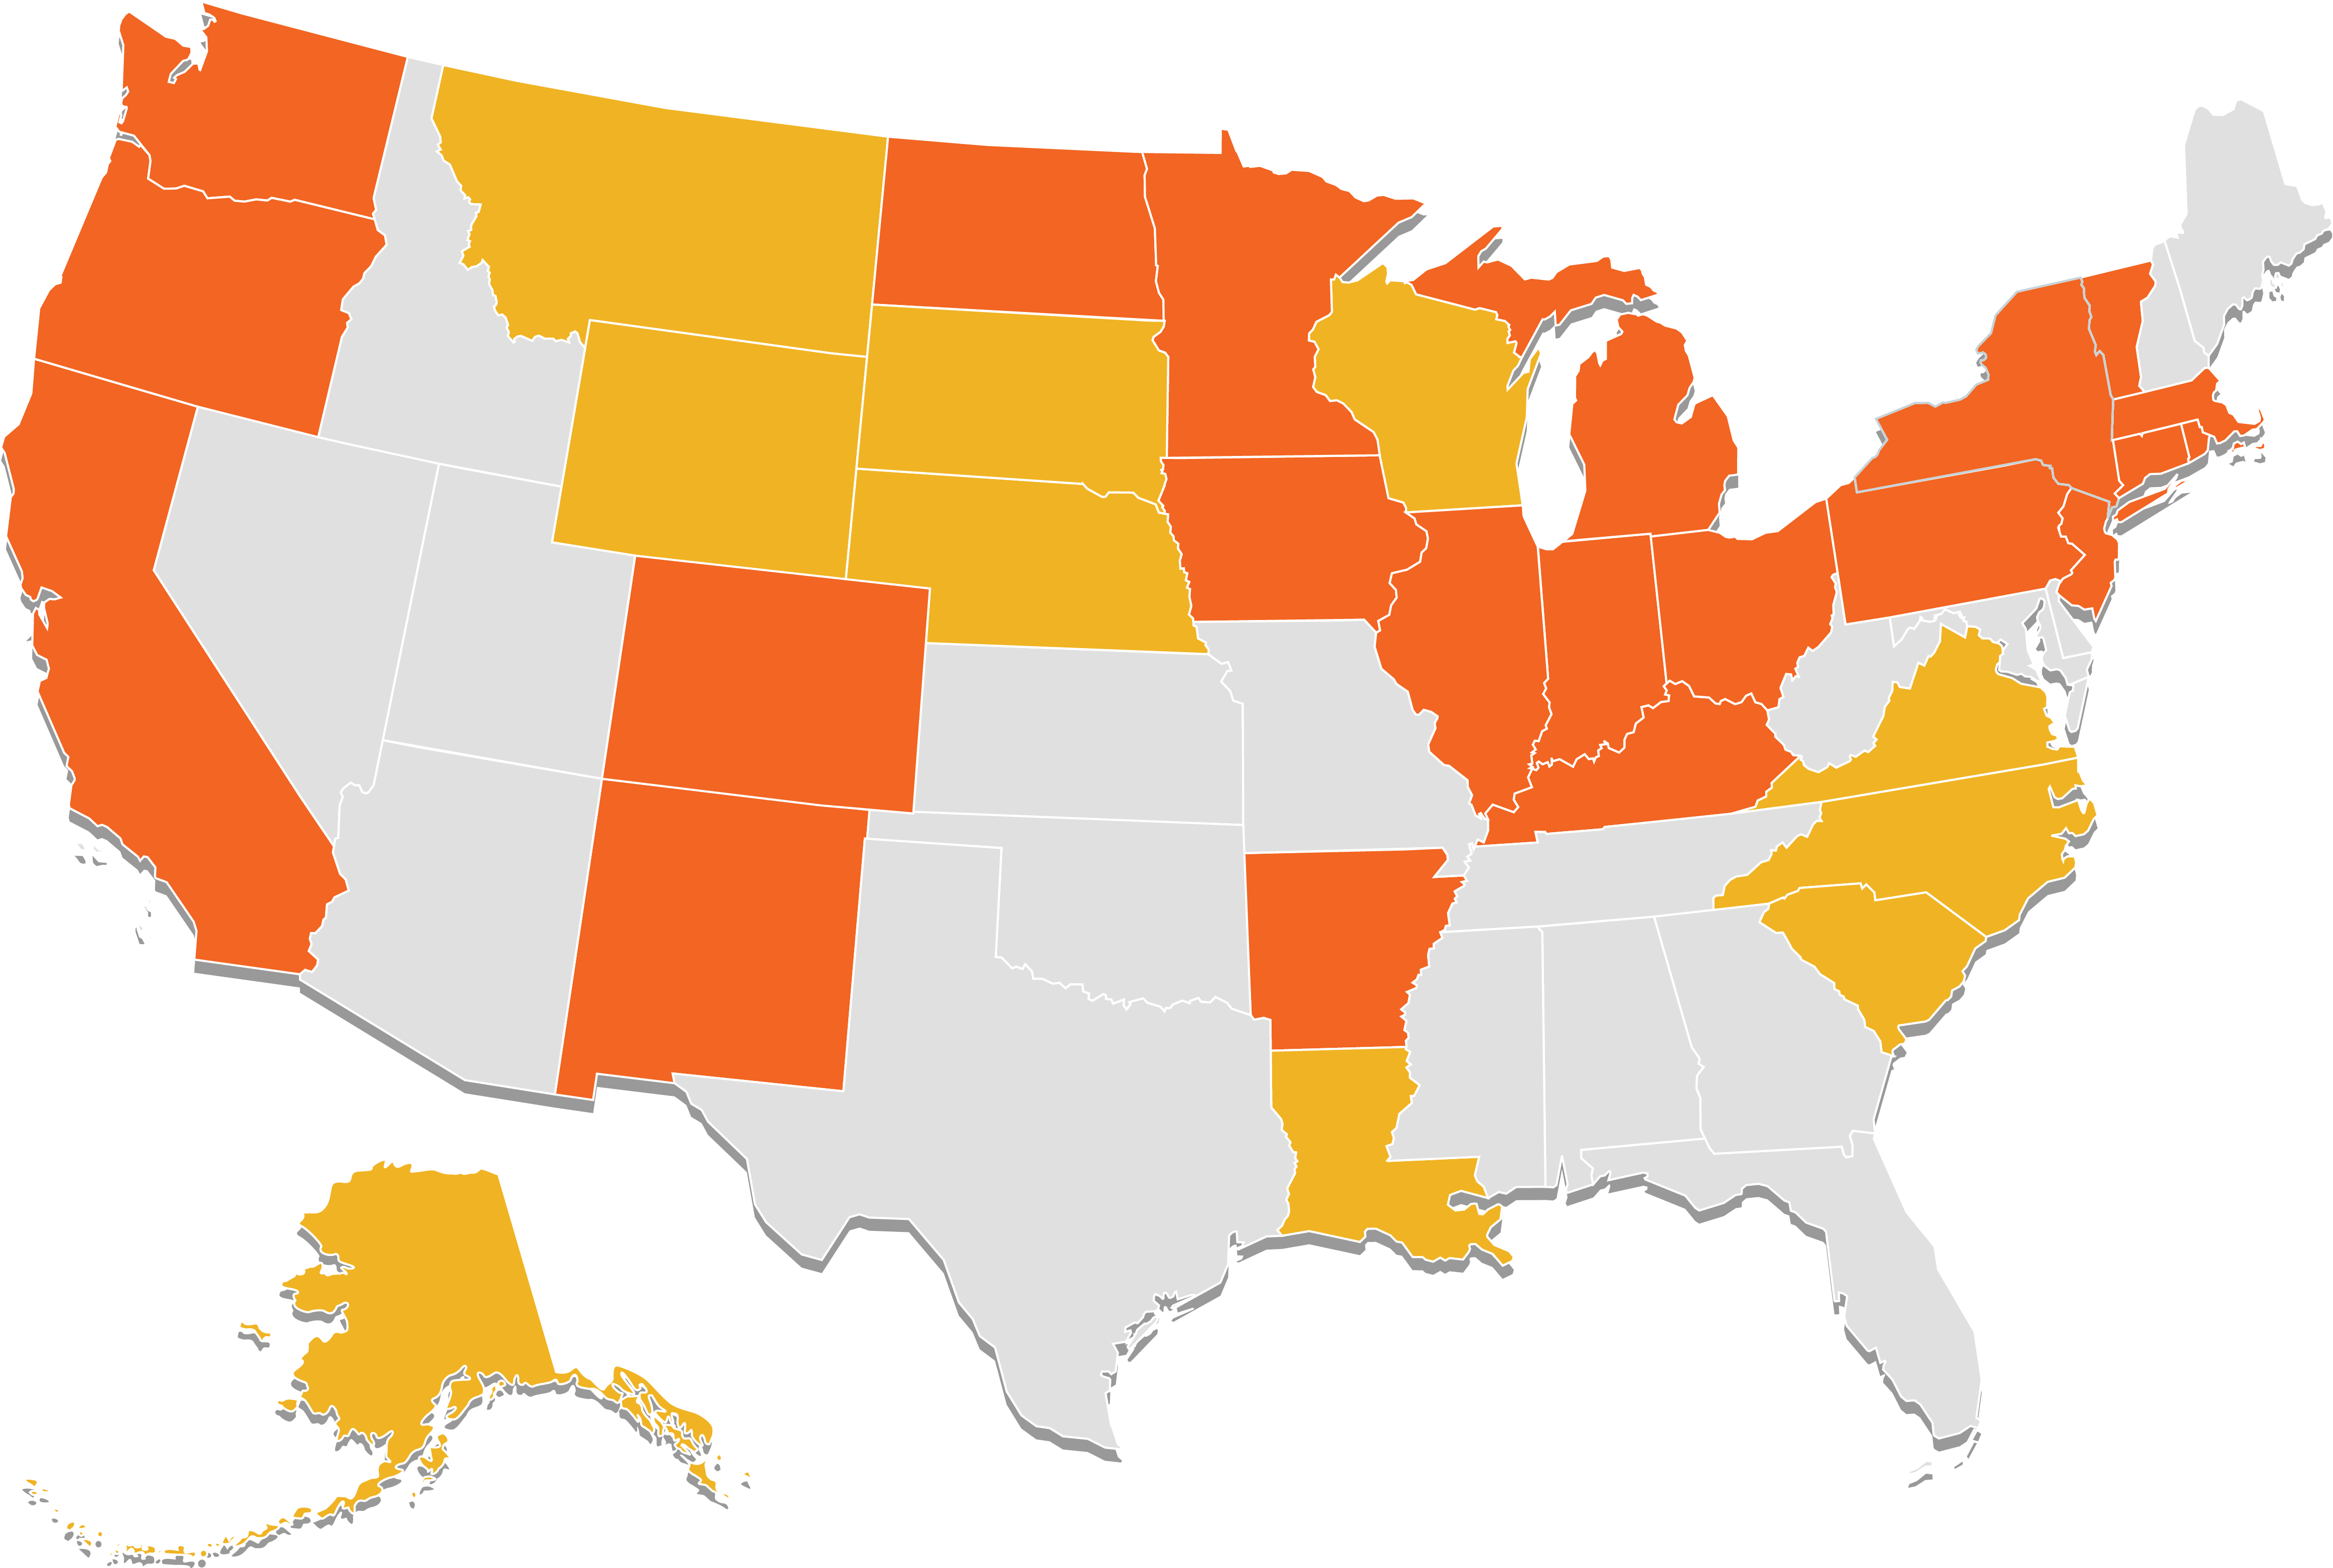
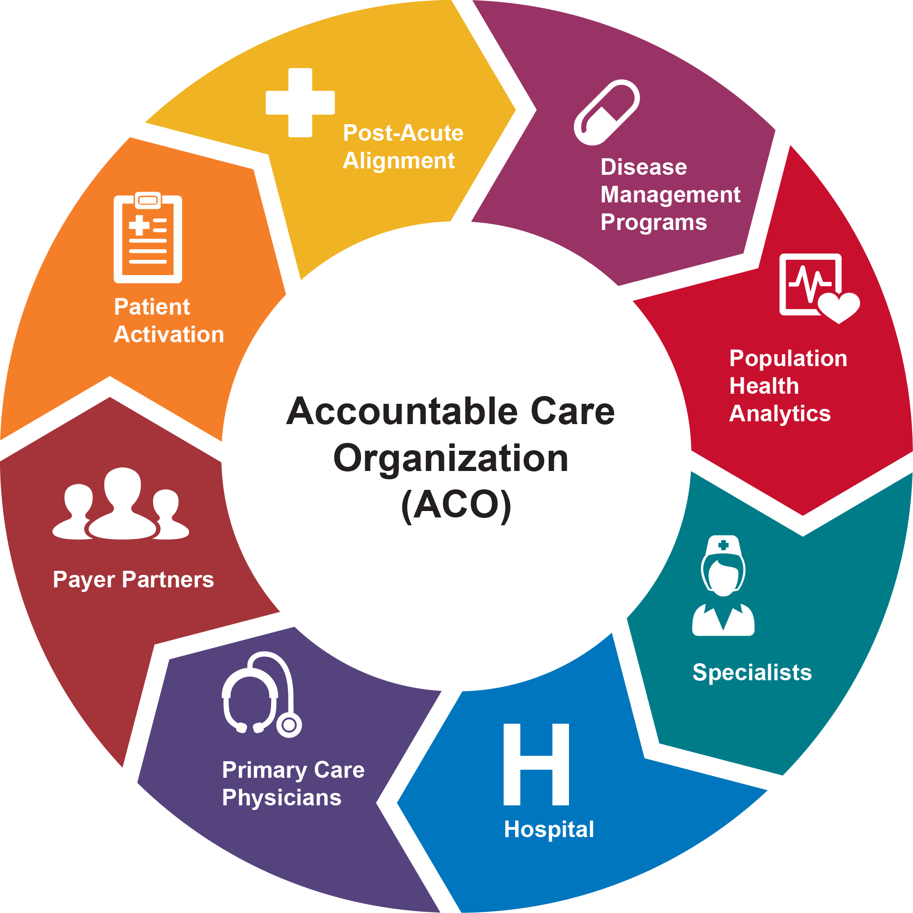

Forces Reshaping the Profession
The value agenda
Increased consumerism
Shifting demand patterns
Increased collaboration
Practice consolidation

Slide 6

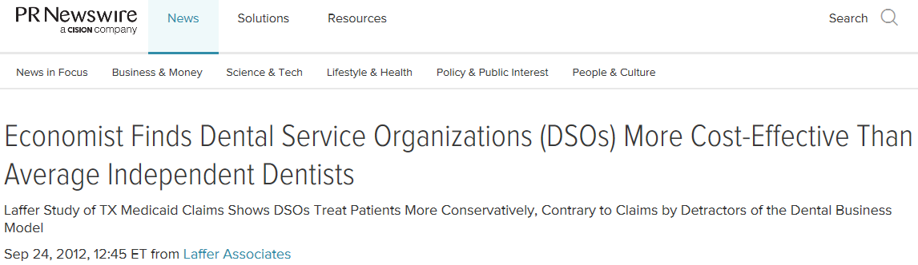
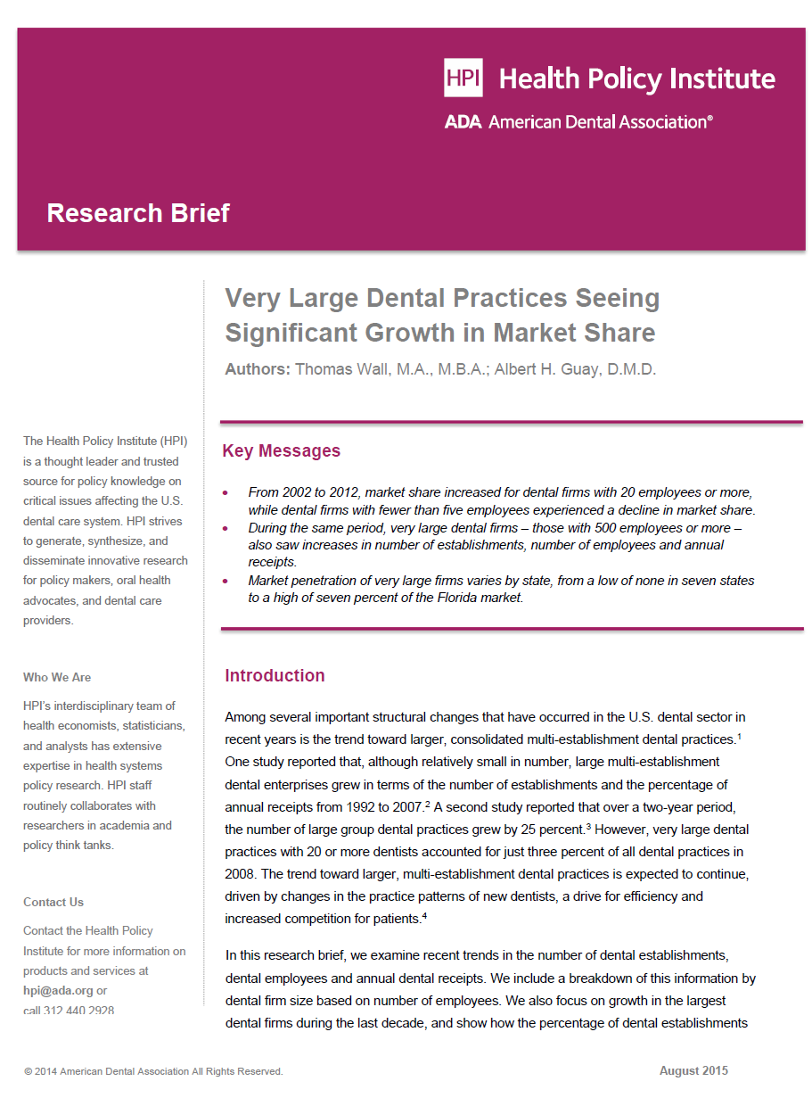
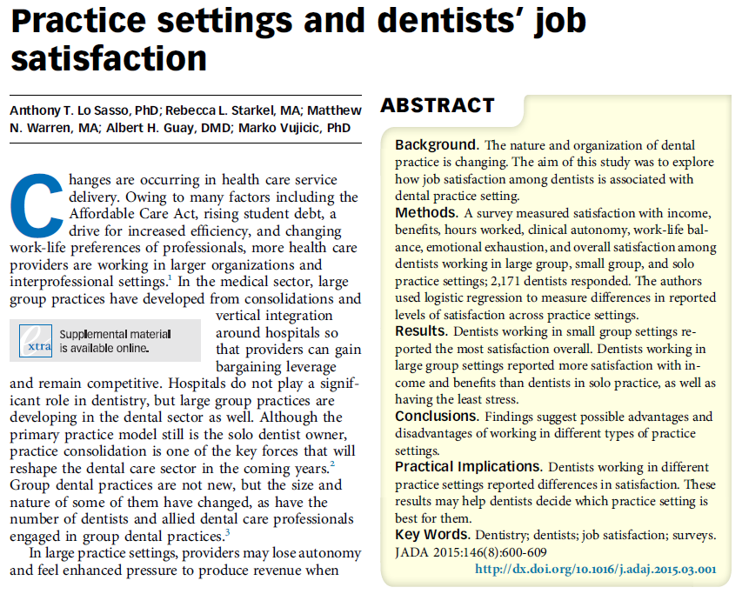
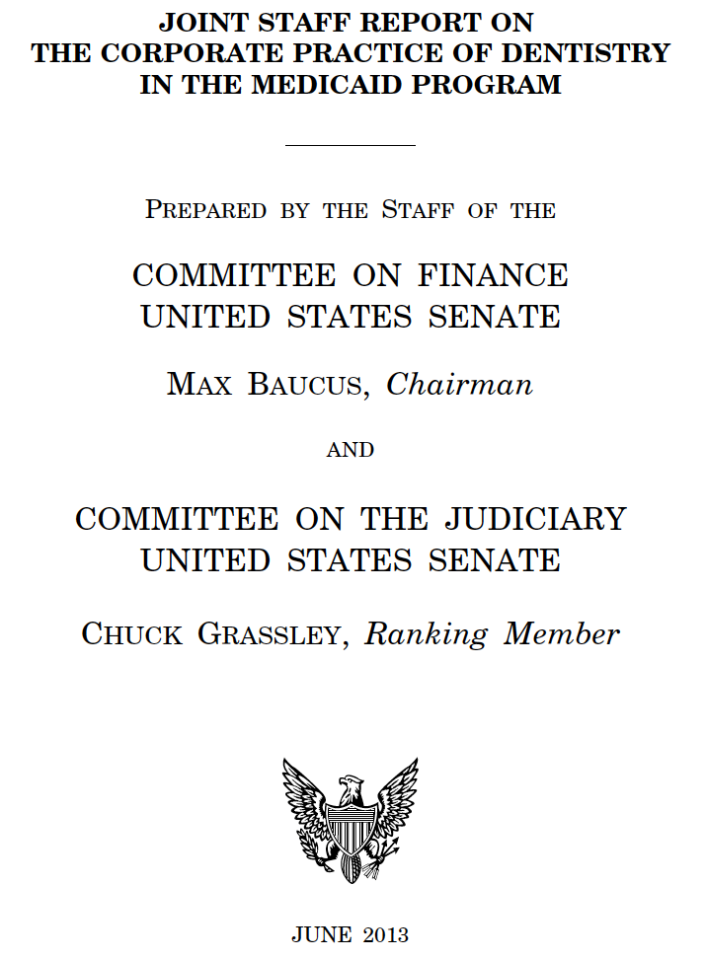
Lots of Debate

Slide 7
New HPI Report
What share of dentists are affiliated with DSOs?
How does this differ by state?
How does this differ by dentist characteristics such as age, gender, specialty, and dental school of graduation

Slide 8
New HPI Report
A dentist is considered to be affiliated with a DSO if...
  one or more locations they practice in is a member of the Association of Dental Support Organizations (ADSO) or American Dental Partners, Kool Smiles Inc., and Western Dental
Analysis is as of November 2015
Based on ADA masterfile and data from ADSO member websites
Not perfect. But allows us to track over time.

Slide 9
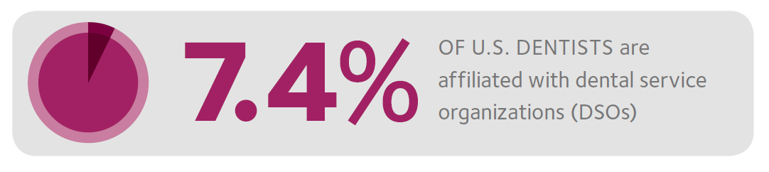
New HPI Report

Slide 10
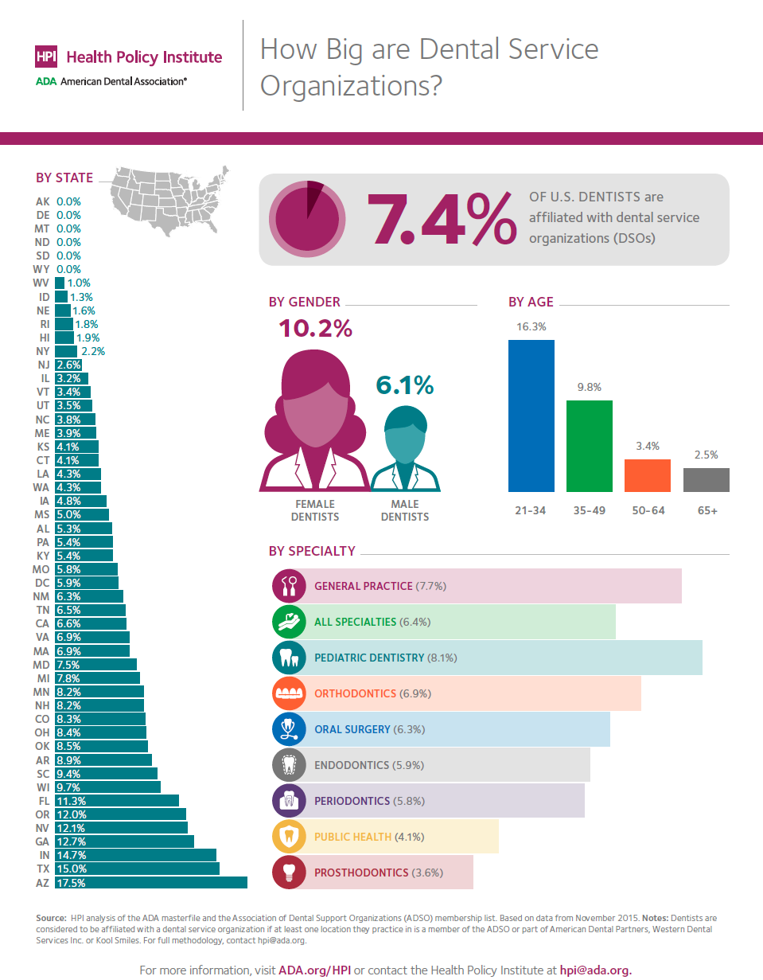
New HPI Report
ADA.org/HPI

Slide 11
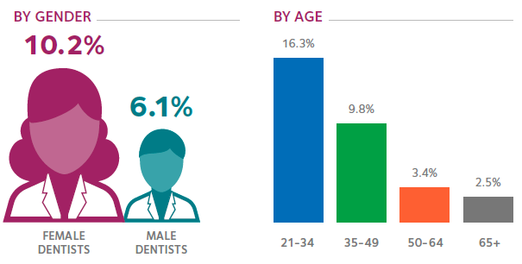
New HPI Report

Slide 12
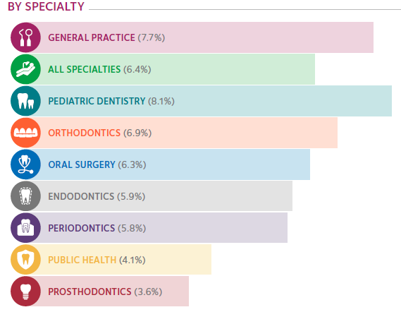
New HPI Report

Slide 13
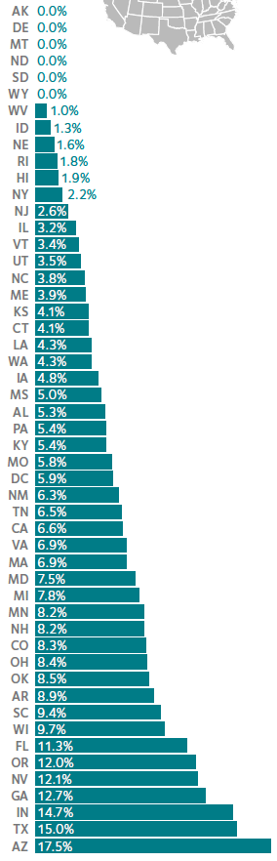
New HPI Report

Slide 14
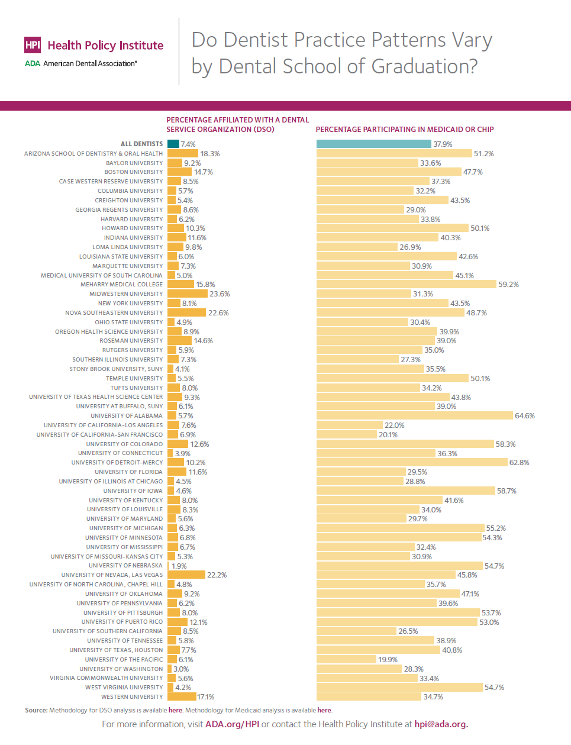
New HPI Report
ADA.org/HPI

Slide 15
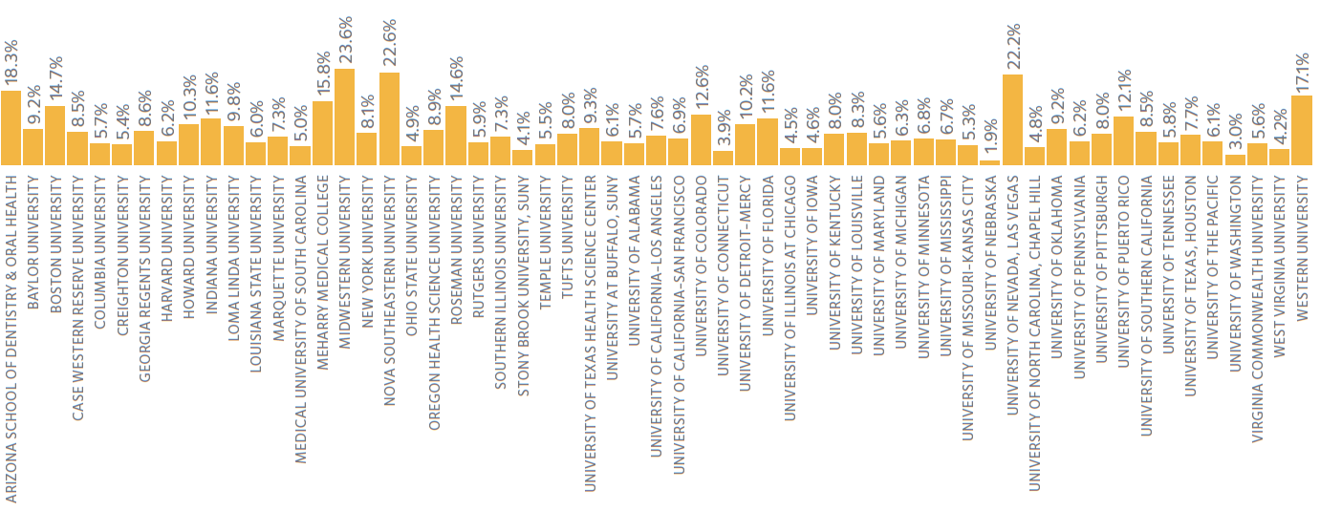
New HPI Report

Slide 16
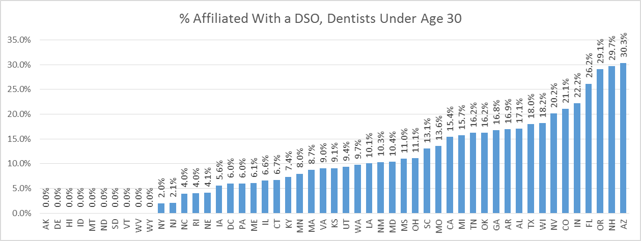
Coming Soon

Slide 17
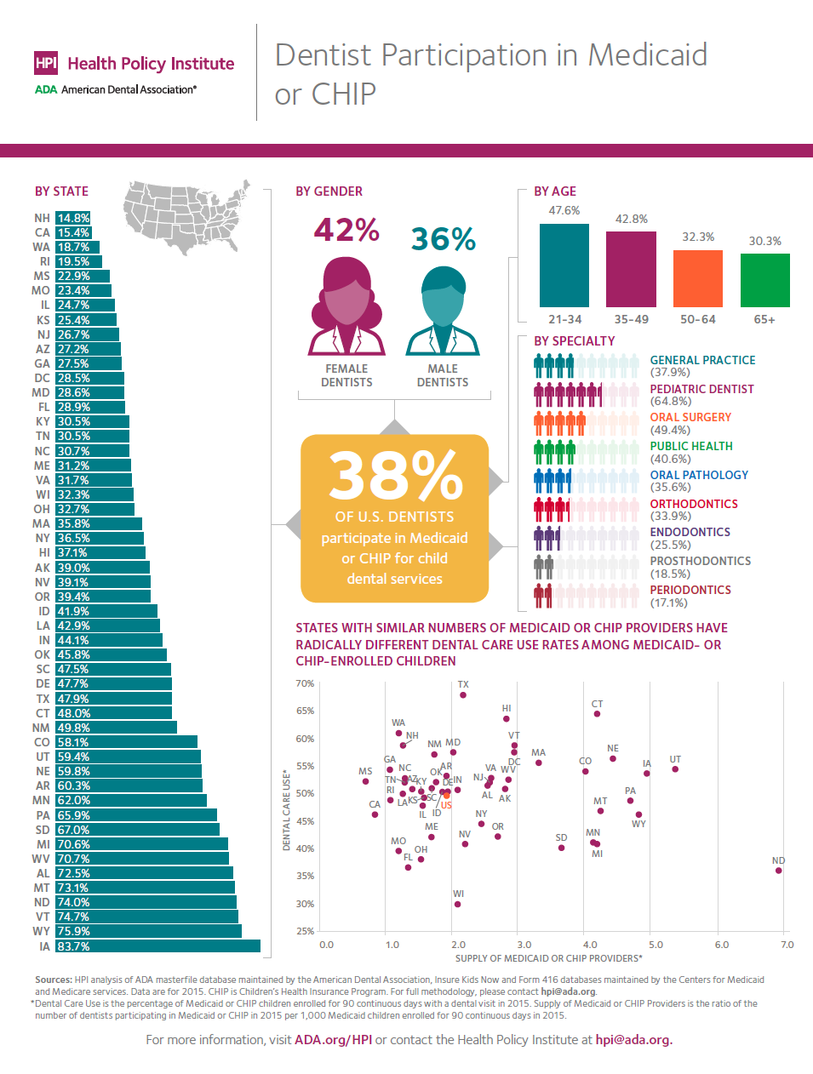
Coming Soon

Slide 18
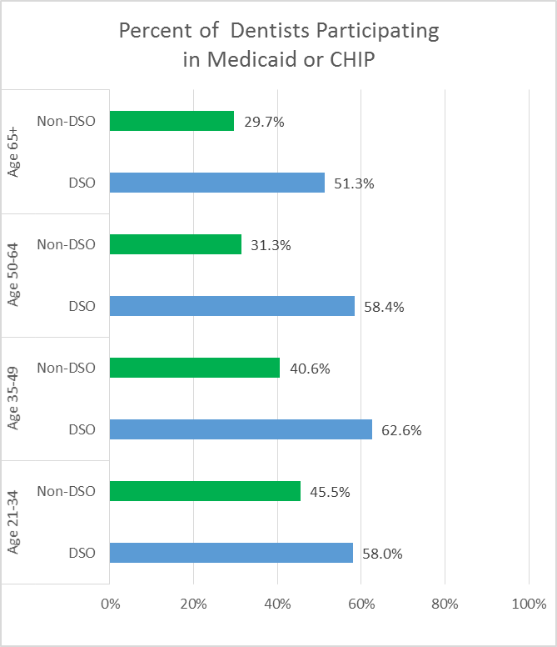
Coming Soon

Slide 19

Dave Preble
Vice President, Practice Institute

Slide 20
Stephen Thorne
Founder, President & CEO, Pacific Dental Services

Slide 21

Dmitry Edelchik
Director of Marketing, Planmeca USA

Slide 22


Thank You!
@ADAHPI
ADA.org/HPI
hpi@ada.org

