Slide 1
The Gender Pay Gap in Medicine, Law, and Dentistry
Thank you for joining! You will be on hold until the call begins at 11:30 a.m. Central time
Please remember to mute your phone unless you are speaking.
This webinar will be recorded.
Streaming audio is available through your computer
If you’d like to call in to listen to the audio via phone, dial (888) 299-7210 and enter conference ID: 814413

Slide 2
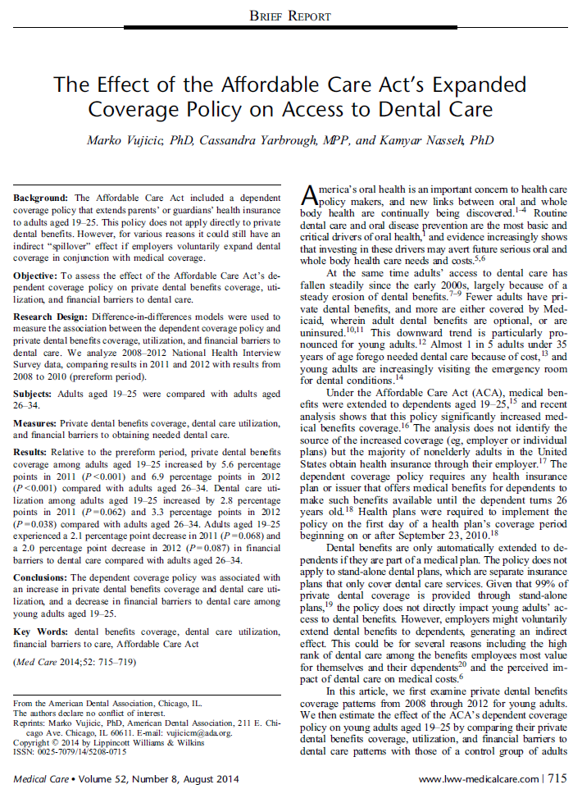
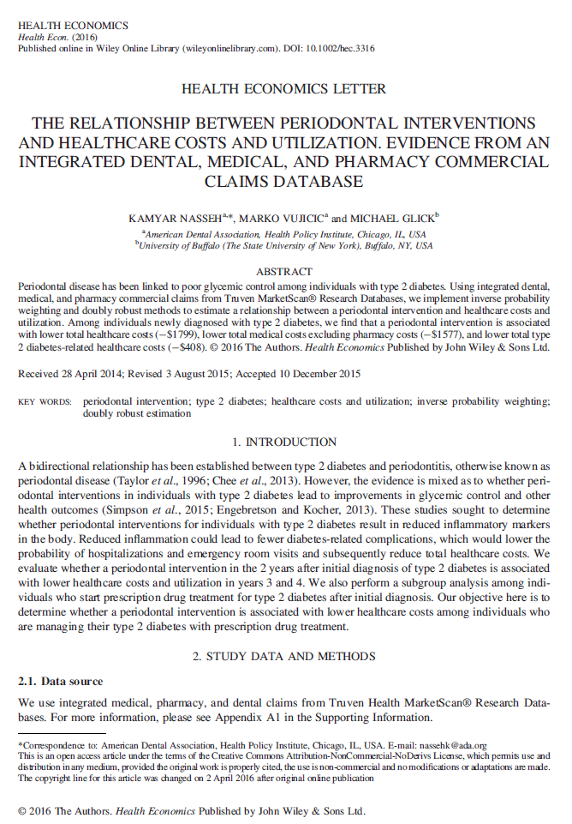
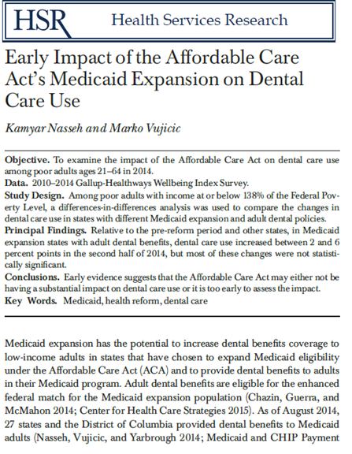
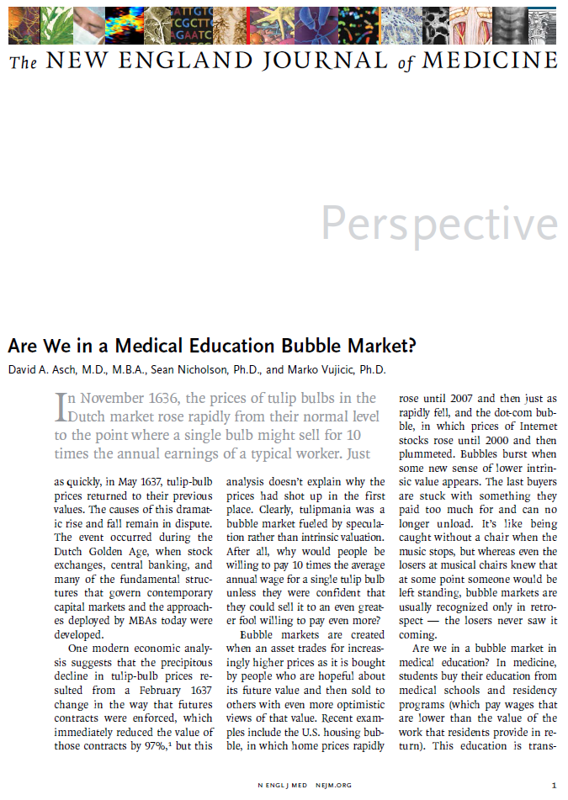
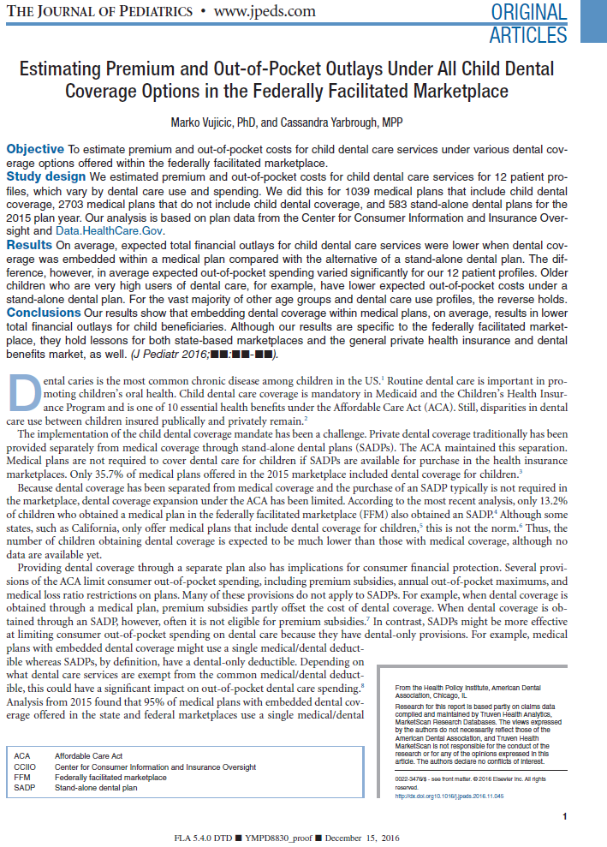
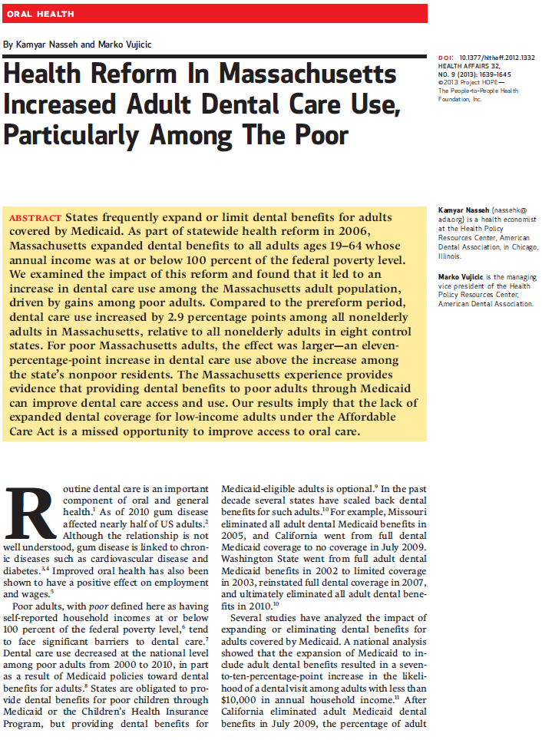
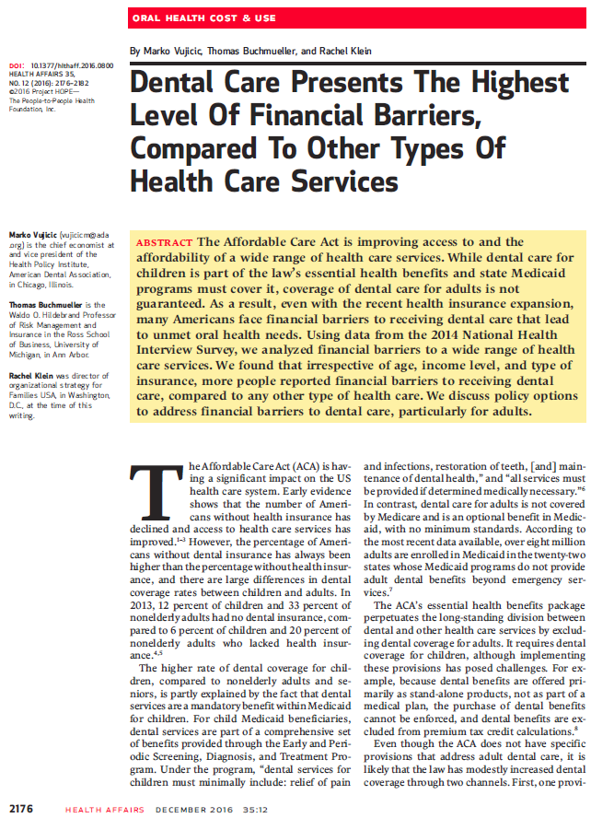
The ADA Health Policy Institute

Slide 3

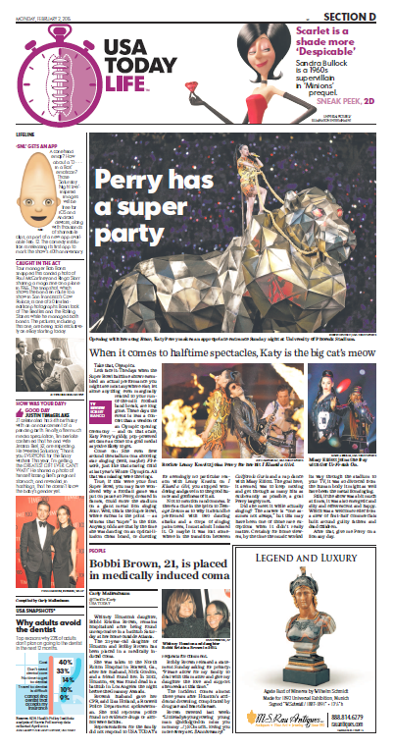
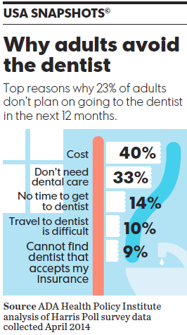
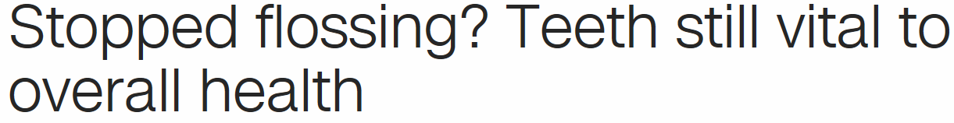

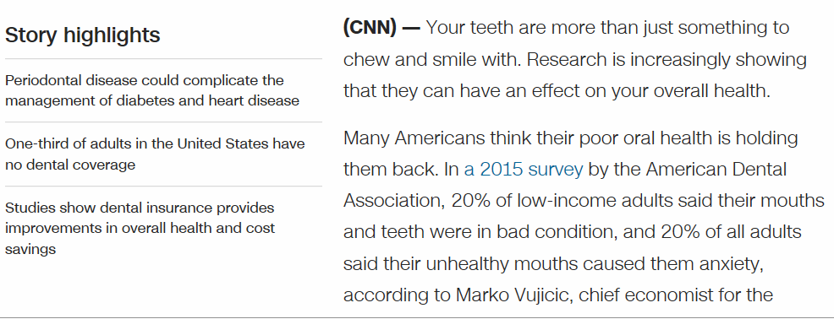

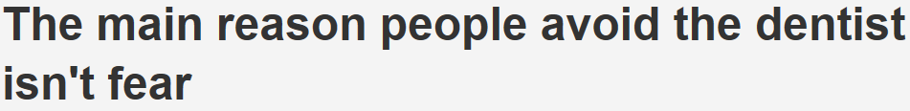
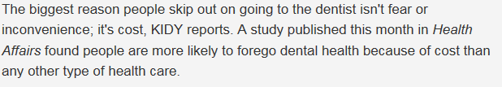
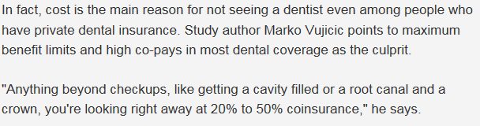
The ADA Health Policy Institute

Slide 4

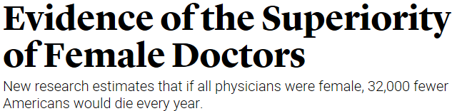


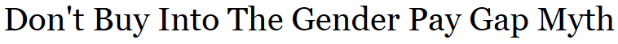


Tonight

Slide 5
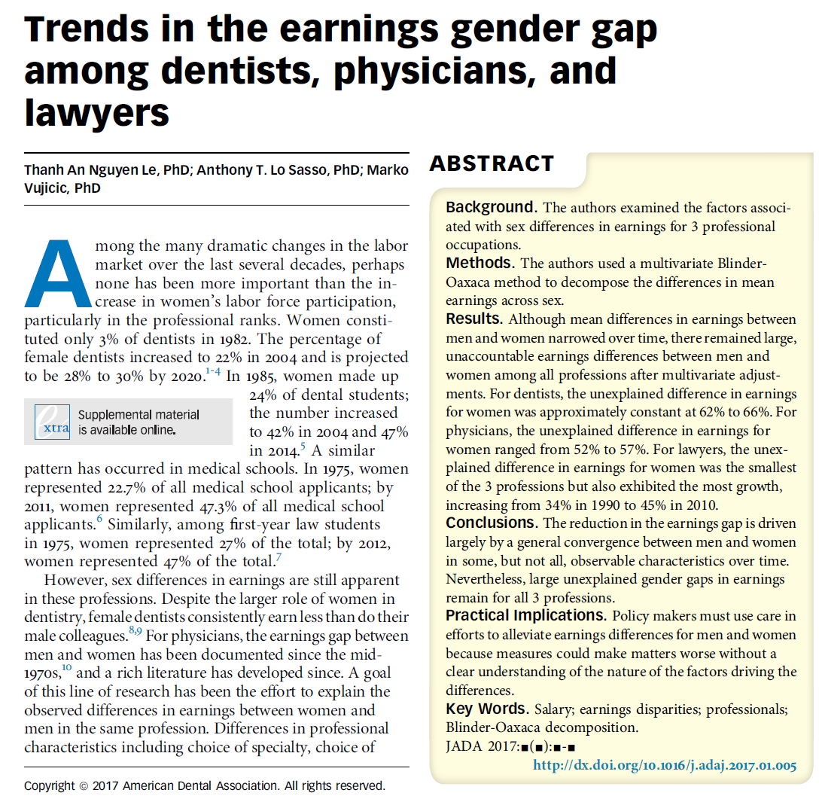
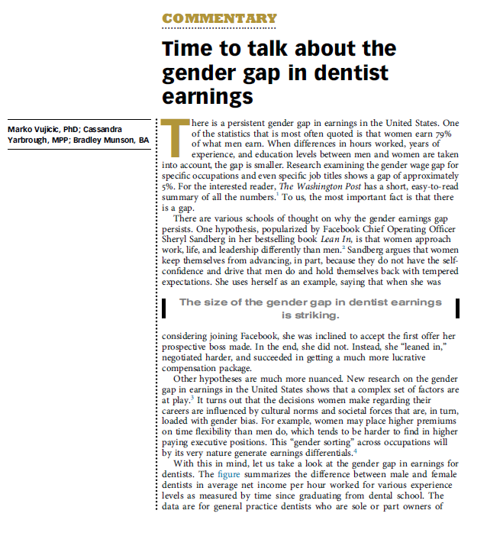
Tonight

Slide 6
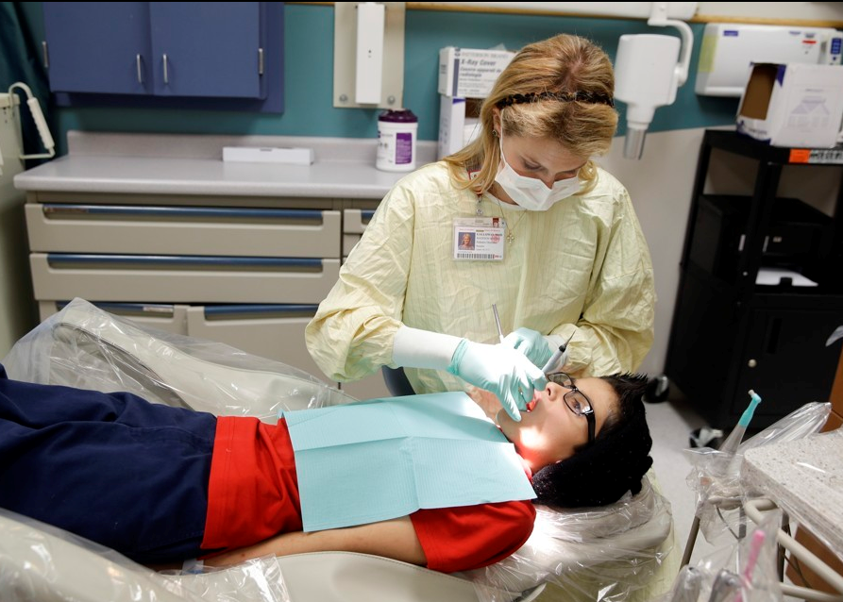

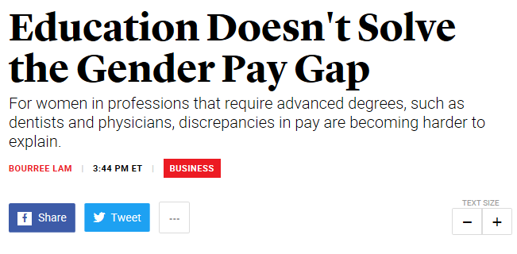
Tonight

Slide 7
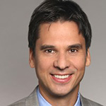
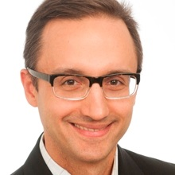
Tonight – Presentation
CHAIR
Marko Vujicic, PhD, Chief Economist & Vice President, ADA Health Policy Institute
PRESENTATION
Tony LoSasso, PhD, Professor, Division of Health Policy & Administration, School of Public Health, University of Illinois at Chicago

Slide 8
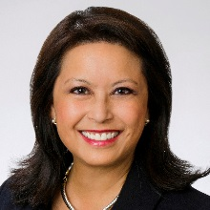
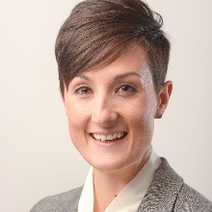
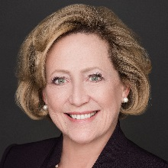
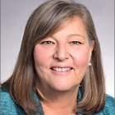
Tonight – Roundtable
Carol Gomez Summerhays, DDS, Past President, American Dental Association
Diana Lautenberger, MA, Director, Women in Medicine & Science, Association of America Medical Colleges
Lisa Simpson, MB, BCh, MPH, FAAP, President & CEO, AcademyHealth
Patricia (Pat) Gillette, J.D., Lawyer, Author, and former member of the American Bar Association Commission on Women in the Profession and the Task Force on Gender Equity

Slide 9
Let’s Get Your Views
Polling

Slide 10
The Study
We set out to….
  Measure earnings differences between male and female dentists, physicians, lawyers
  Analyze trends over time
  Identify how much of the gender gap could be explained by “observable” characteristics (e.g. age, hours worked, # of children, ownership of practice) and how that changes over time

Slide 11
The Study
Data
  IPUMS Census data
  American Community Survey
  Three timeframes: 1990, 2000, 2010
Methods
  Oaxaca-Blinder method to decompose earnings gap into:
    “explained” (e.g. men have different characteristics than women)
    “unexplained” (e.g., after accounting for those different characteristics there’s still a gap)

Slide 12
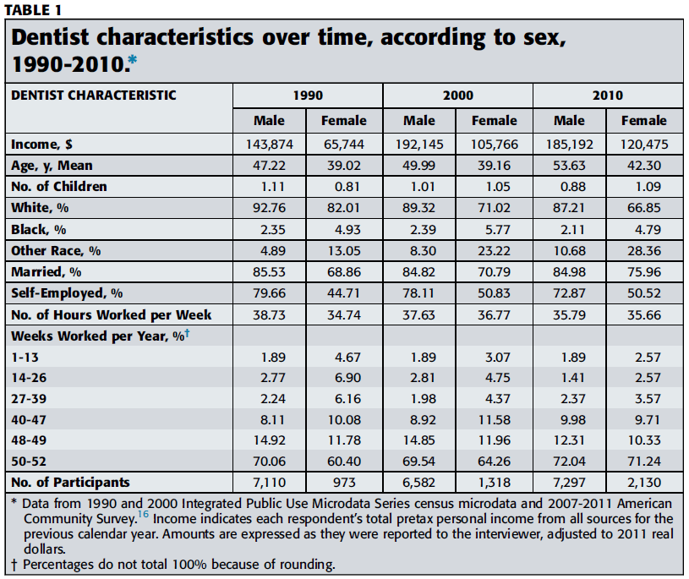
The Study

Slide 13
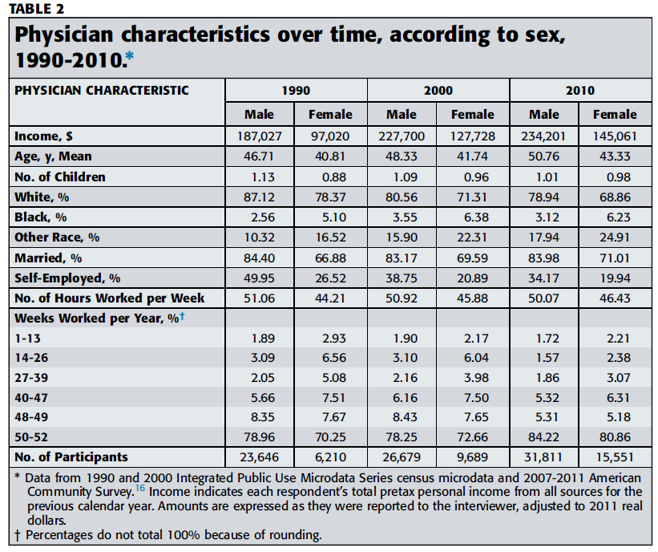
The Study

Slide 14
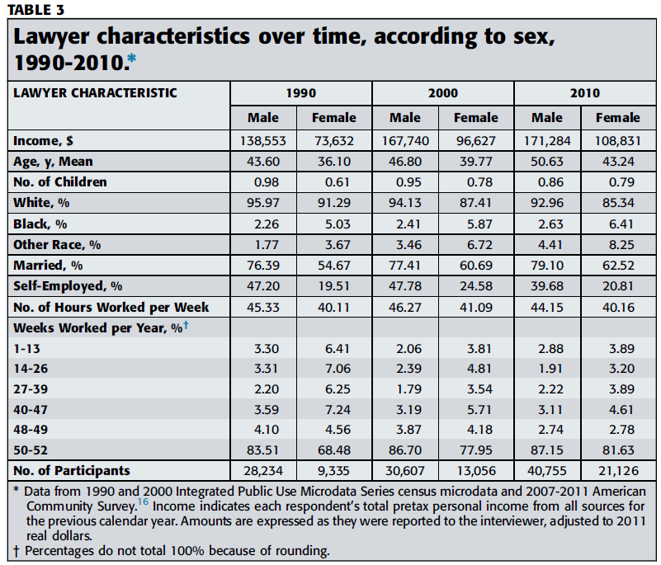
The Study

Slide 15
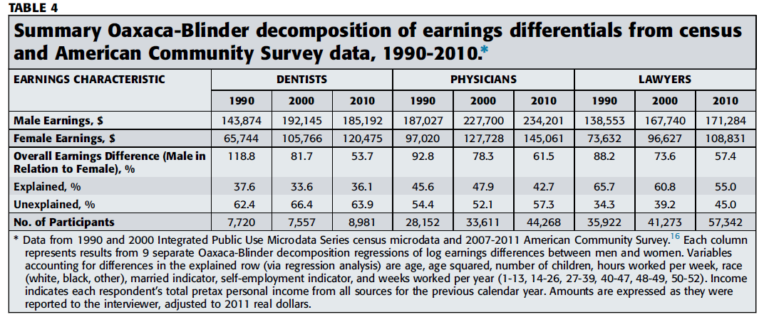
The Study

Slide 16
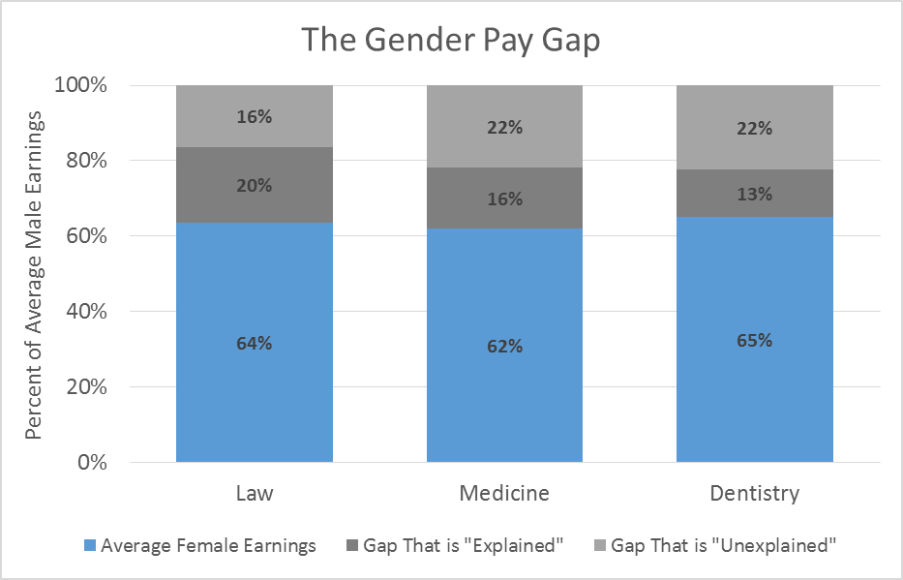
The Study: 2010

Slide 17
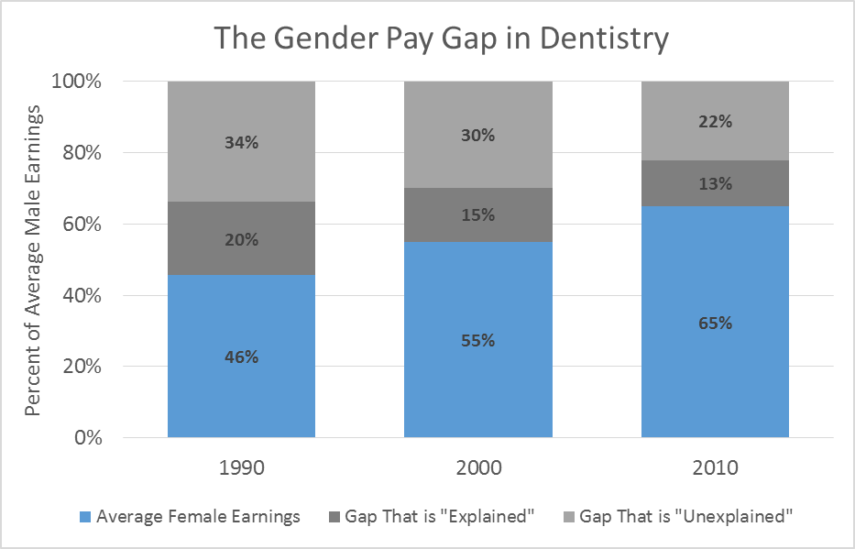
The Study: Gap for Dentists Over Time

Slide 18
The Study
The gender earnings gap is shrinking in dentistry, medicine, and law
A big part of this is because women are “looking” more like men in terms of observable characteristics
There is still a large component of the gender earnings gap that is not explained
  Are we missing important variables? (e.g. specialty)
  Are we missing differences in practice style? (e.g. Medicaid acceptance)
Further research needed to explore these issue

Slide 19



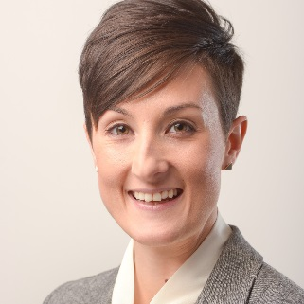
Roundtable
Marko Vujicic, PhD, Chief Economist & Vice President, ADA Health Policy Institute
Carol Gomez Summerhays, DDS, Past President, ADA
Diana Lautenberger, MA, Director, Women in Medicine & Science, Association of America Medical Colleges
Tony LoSasso, PhD, Professor, Division of Health Policy & Administration, School of Public Health, University of Illinois at Chicago
Lisa Simpson, MB, BCh, MPH, FAAP, President & CEO, AcademyHealth
Patricia (Pat) Gillette, JD, Lawyer, Author, and former member of the ABA Commission on Women in the Profession and the Task Force on Gender Equity

Slide 20
Let’s Get Your Views
Polling

Slide 21


Thank You!
@ADAHPI
ADA.org/HPI
hpi@ada.org

