Slide 1
Measuring What Matters
A New Way of Measuring Geographic Access to Dental Care Services
Thank you for joining! You will be on hold until the call begins at 11:00 a.m. Central time
Please remember to mute your phone unless you are speaking.
This webinar will be recorded.
Streaming audio is available through your computer
If you’d like to call in to listen to the audio via phone, dial (888) 378-4398 and enter conference ID: 514730

Slide 2
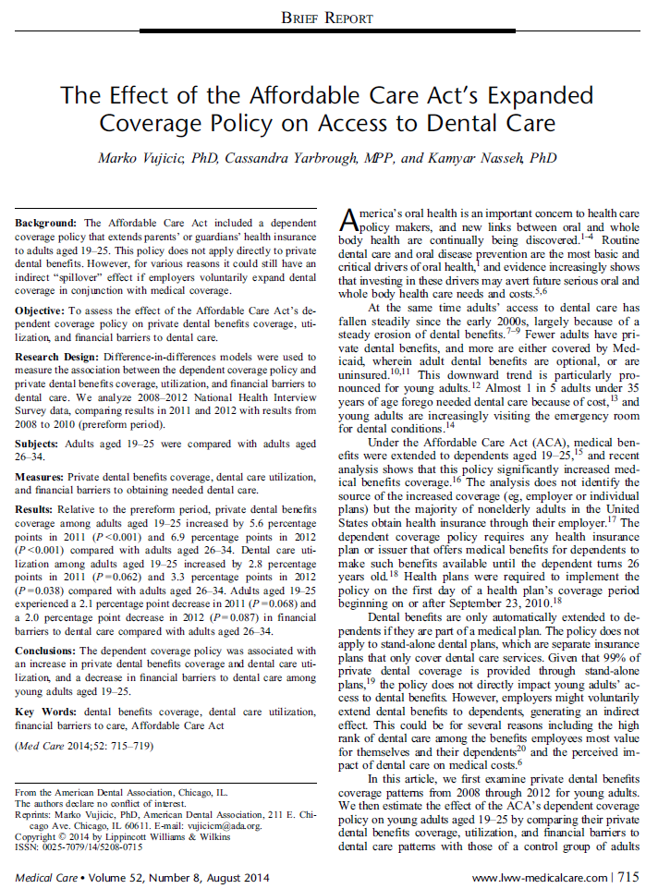
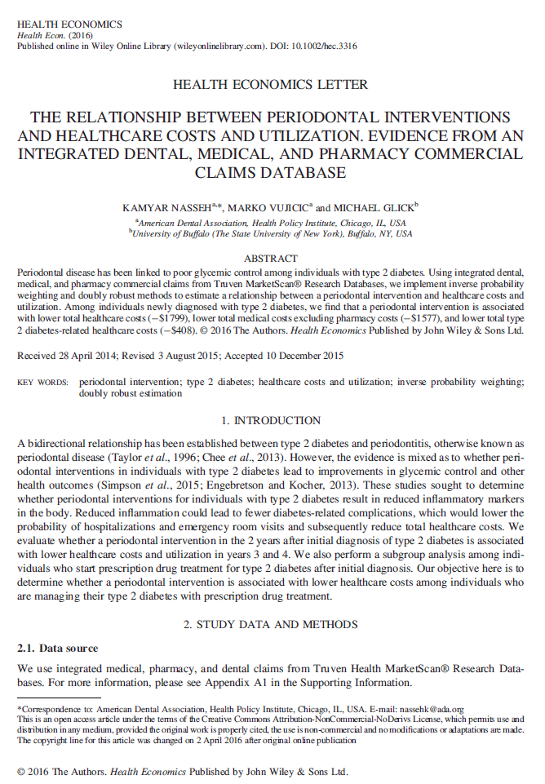
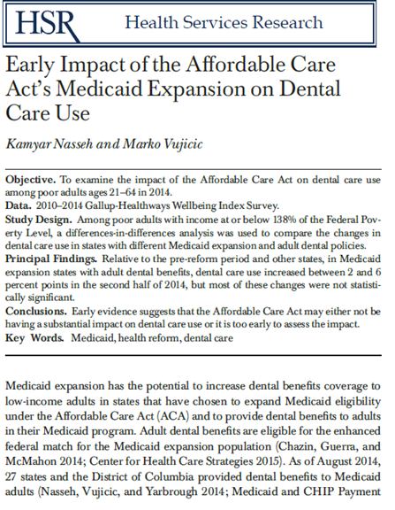
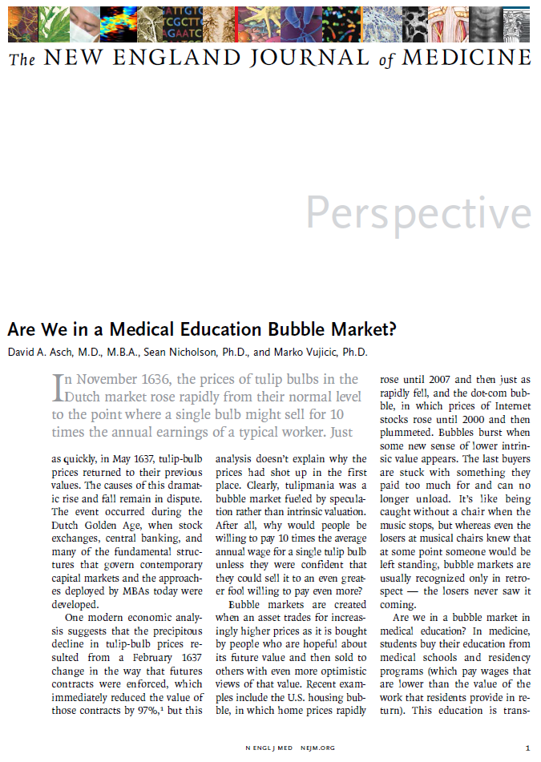
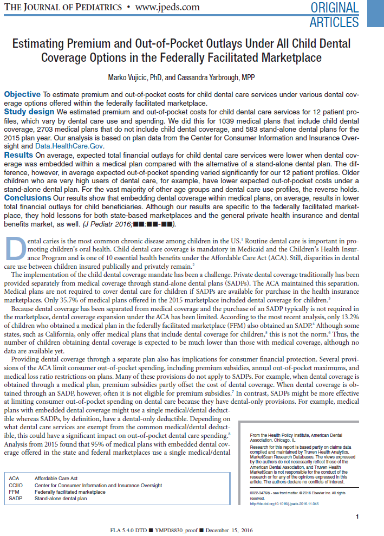
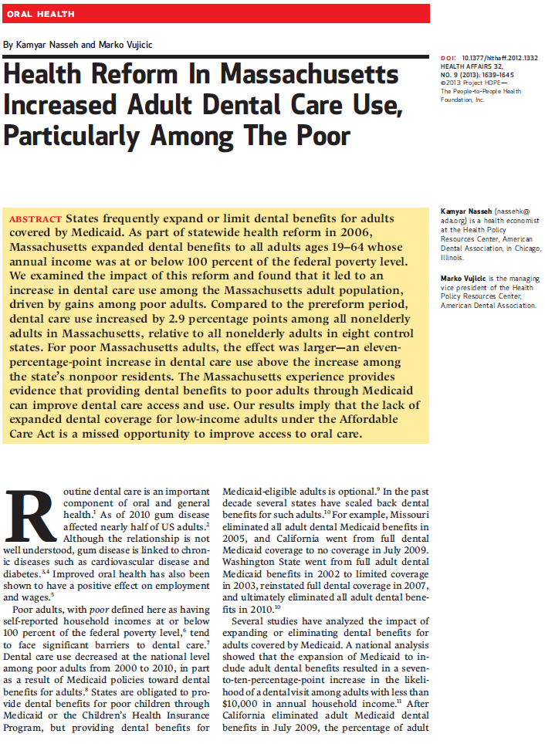
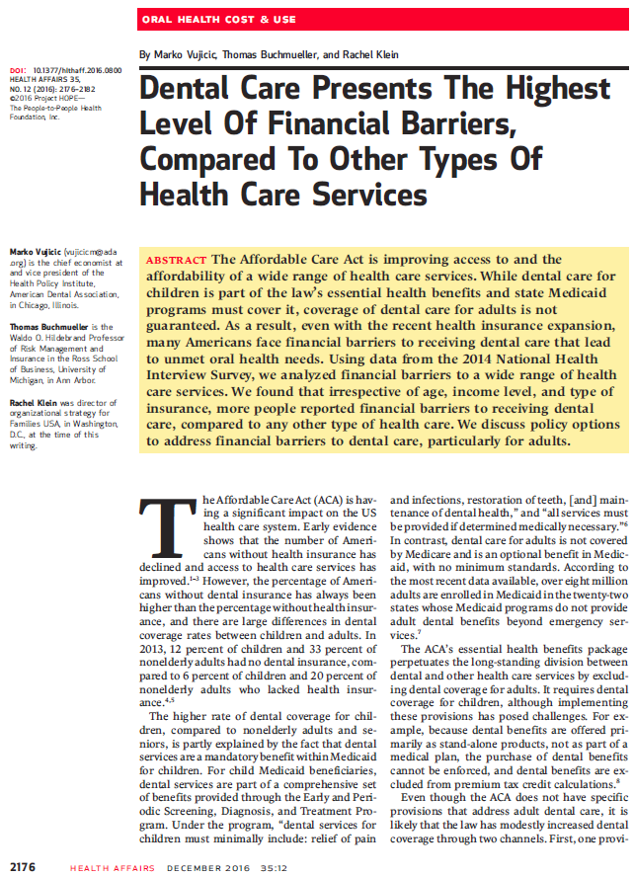
The ADA Health Policy Institute

Slide 3


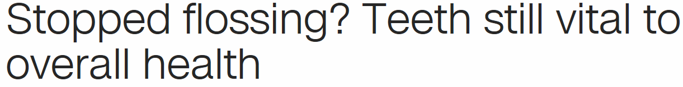

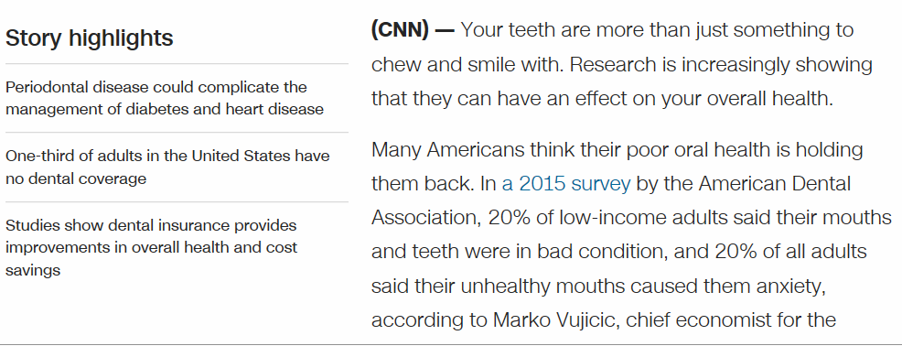
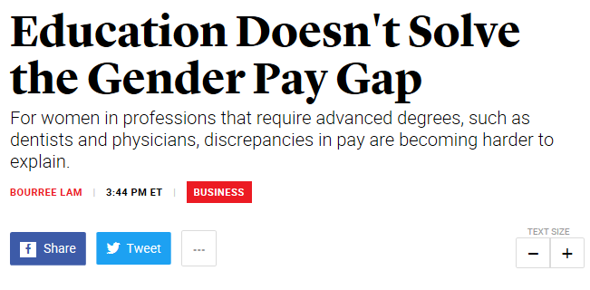

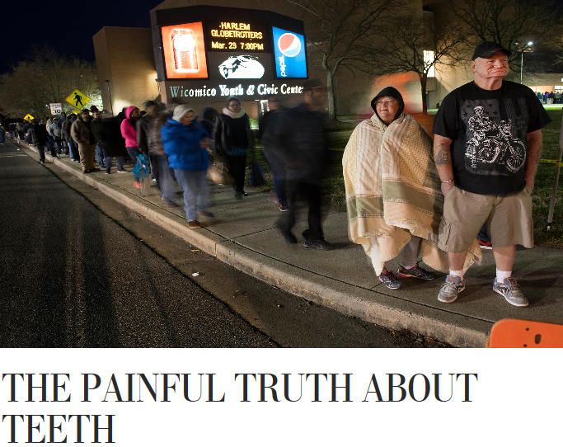


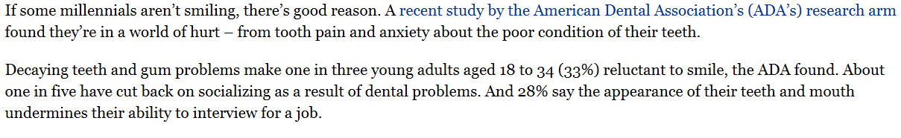
The ADA Health Policy Institute

Slide 4
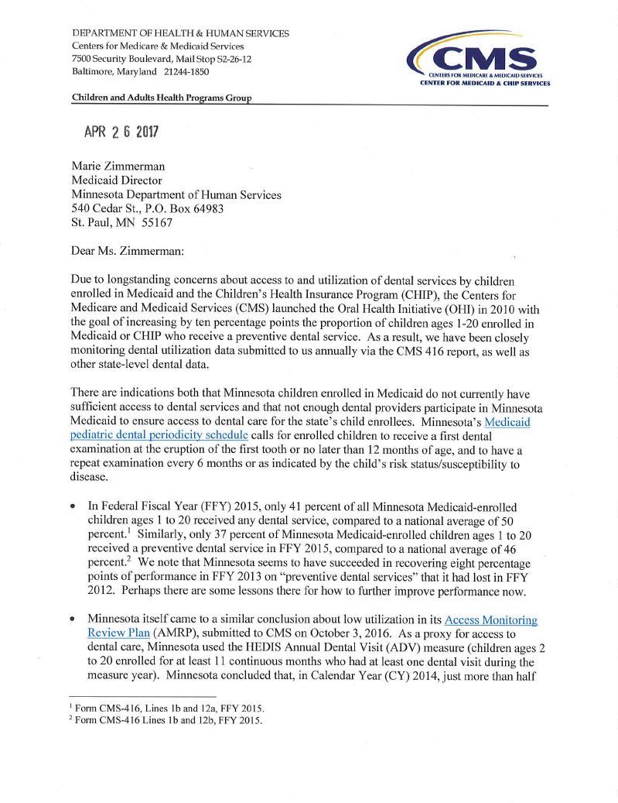
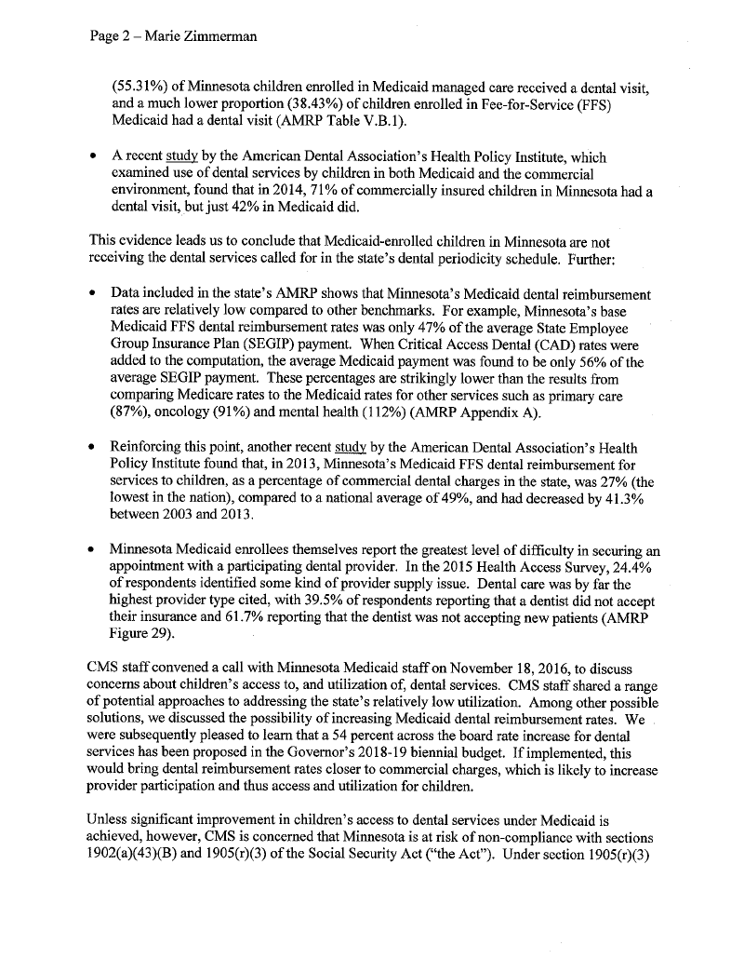
The ADA Health Policy Institute

Slide 5
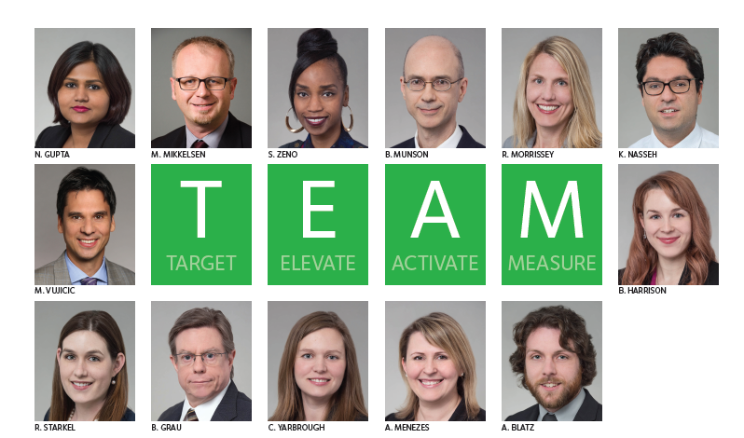
The ADA Health Policy Institute

Slide 6
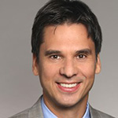


Today
CHAIR
Marko Vujicic, Ph.D., Chief Economist & Vice President, ADA Health Policy Institute
PANELISTS
Jayanth Kumar, DDS, MPH, State Dental Director, California Department of Public Health
Marty Milkovic, MSW, Director of Care Coordination & Outreach,
Connecticut Dental Health Partnership (CTDHP)

Slide 7
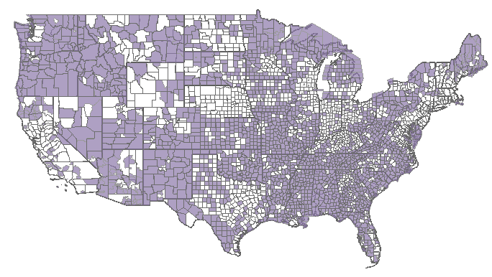
Health Professional Shortage Areas

Slide 8
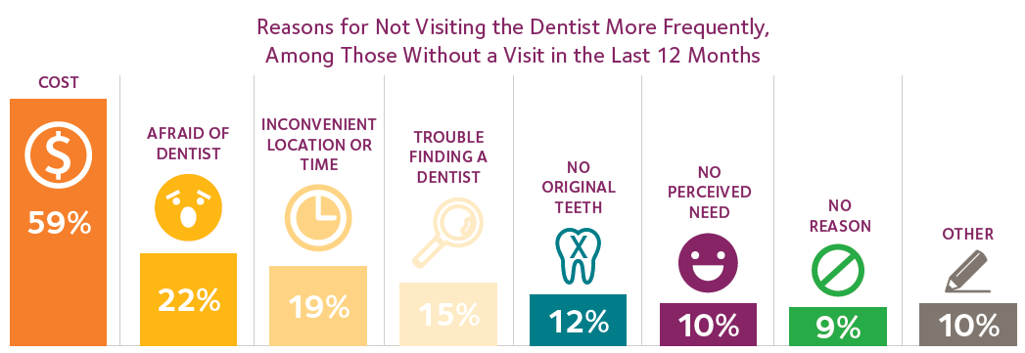
Barriers to Dental Care

Slide 9
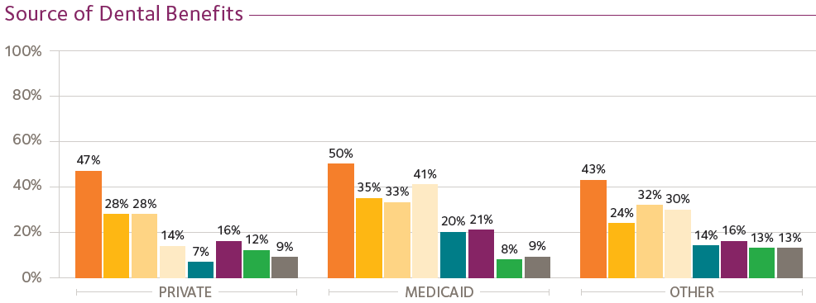
Barriers to Dental Care

Slide 10
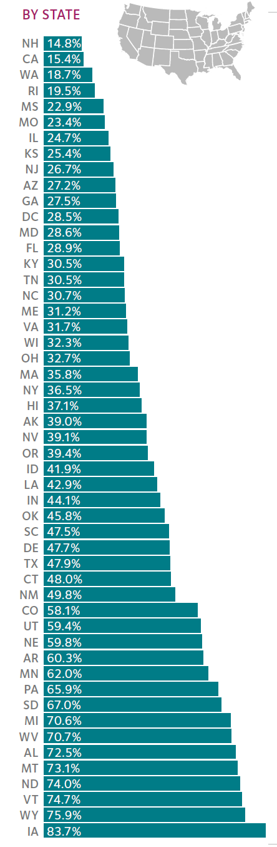
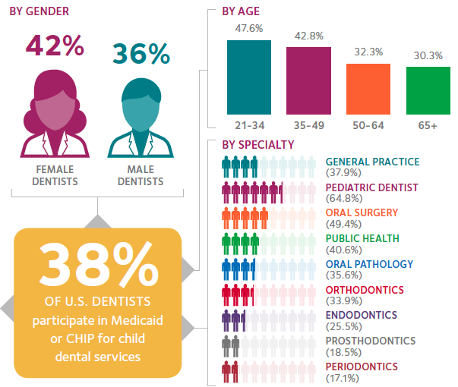
Supply of Medicaid or CHIP Dentists

Slide 11
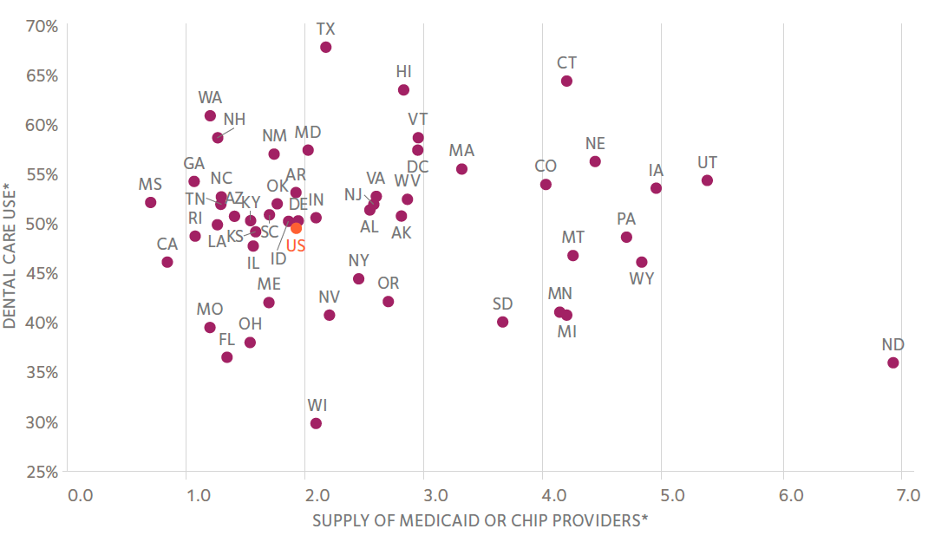
Supply and Dental Care Use

Slide 12
Supply and Dental Care Use

Slide 13
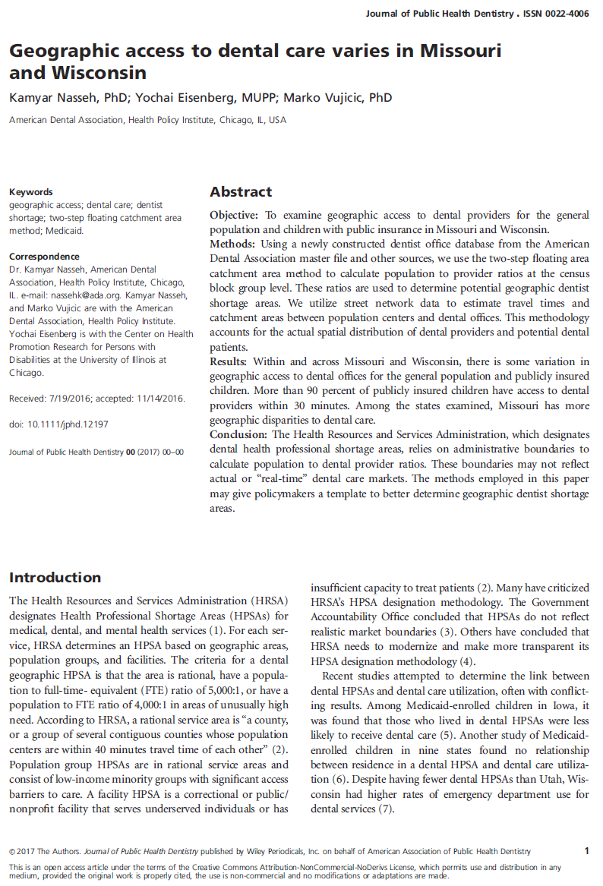
Measuring What Matters
ADA.org/HPI

Slide 14
Methods
PROVIDERS
Map every location where at least one dentist participates in Medicaid or CHIP
Includes FQHCs and dental school clinics
Adjust for FTEs based on age and multiple locations
Based on Insure Kids Now and ADA office data base
POPULATION
Map general population as well as children with public health insurance
Data are at Census tract level
Use population-weighted centroid
Based on Census data
GEO-ANALYSIS
Create 5, 15, 30 minute travel times around population-weighted centroids and dental offices, FQHCs, and dental school clinics
Based on road networks
Use 2SFCA method to measure density of dentists relative to population

Slide 15
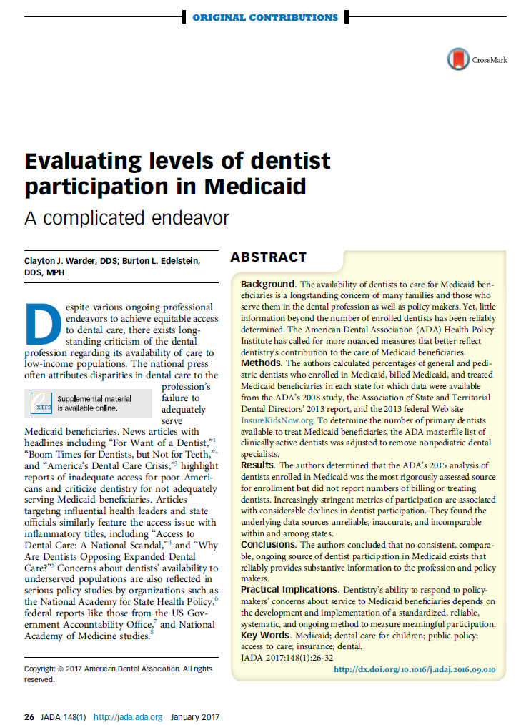
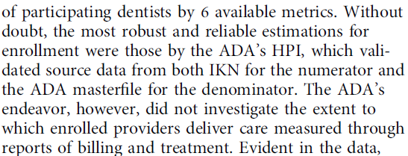
Methods

Slide 16
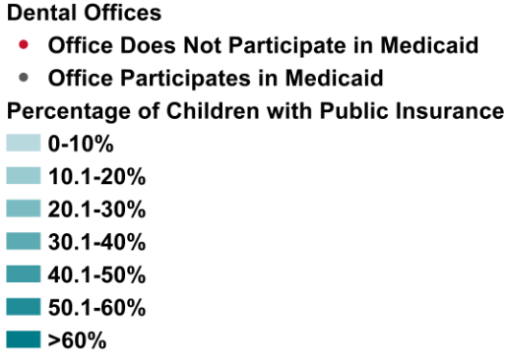
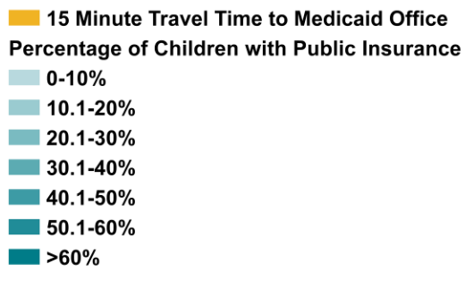
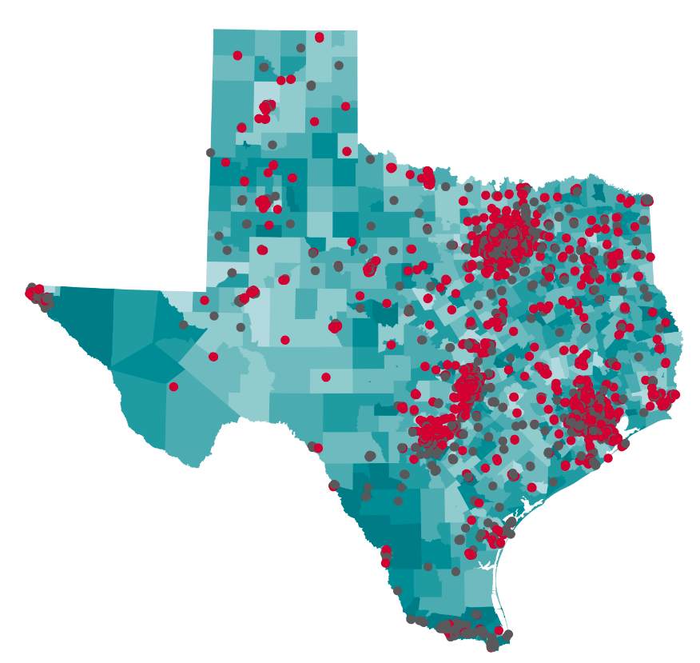
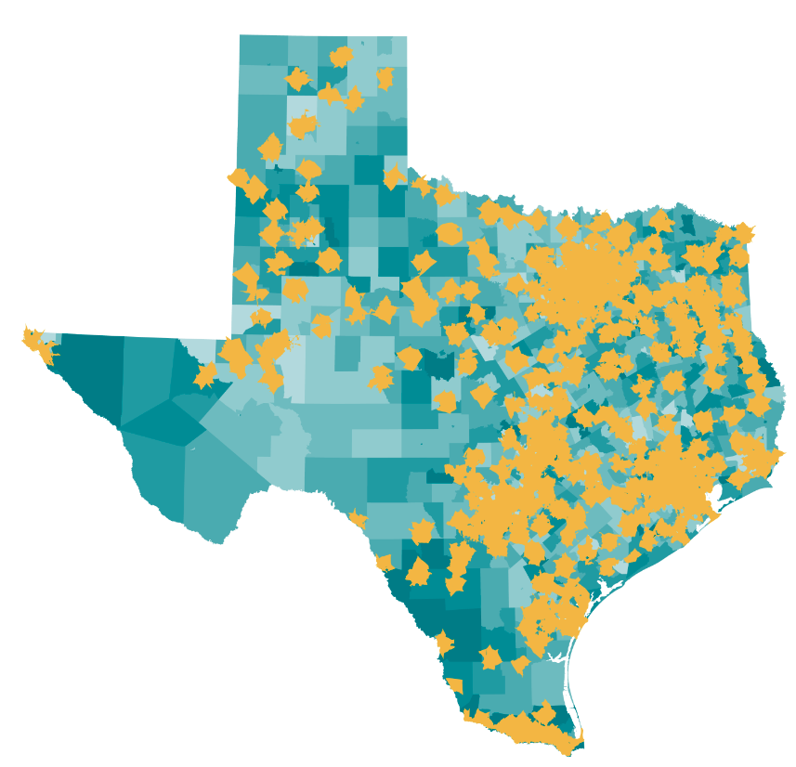
Geographic Access

Slide 17
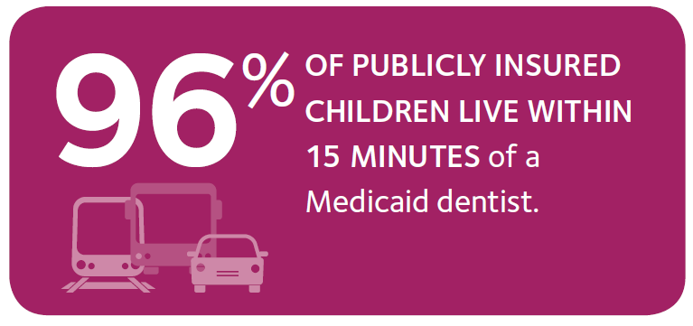
Geographic Access

Slide 18
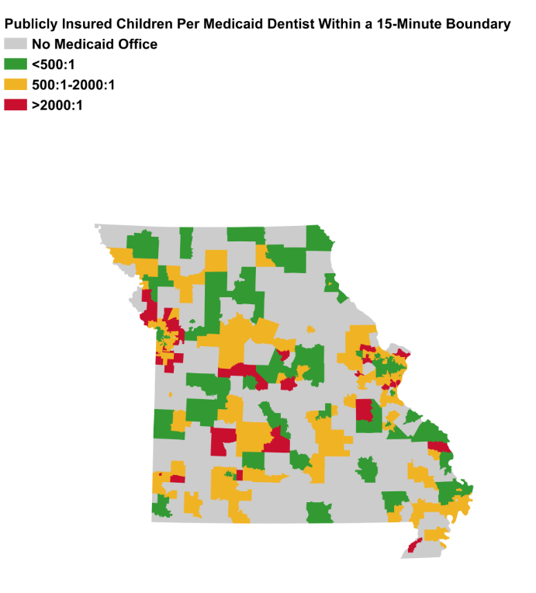
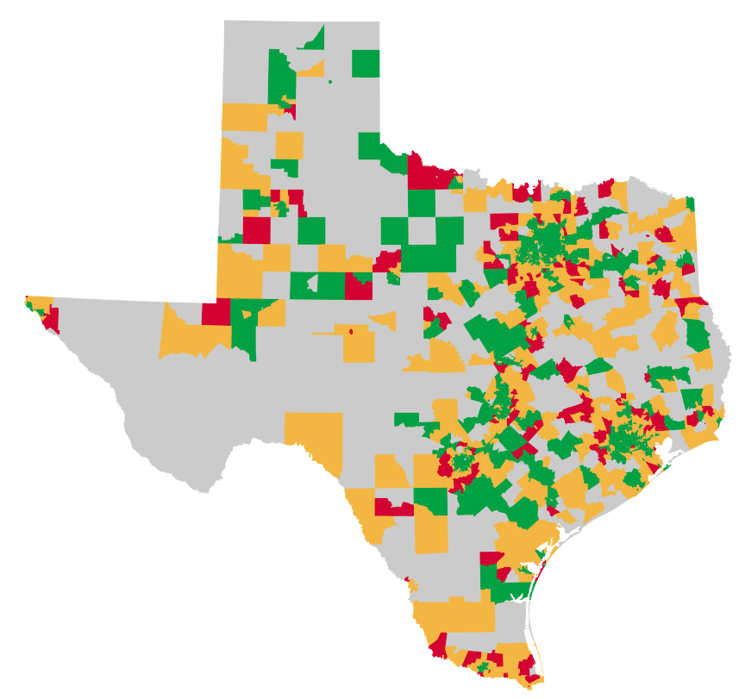
Geographic Access
4% of publicly insured children do not have a Medicaid or CHIP dentist within a 15 minute travel time
56% of publicly insured children live in areas with more than one Medicaid or CHIP dentist within a 15 minute travel time for every 500 publicly insured children
35% of publicly insured children live in areas with one Medicaid or CHIP dentist within a 15 minute travel time for every 500 to 2,000 publicly insured children
5% of publicly insured children live in areas with less than one Medicaid or CHIP dentist within a 15 minute travel time for every 2,000 publicly insured children

Slide 19
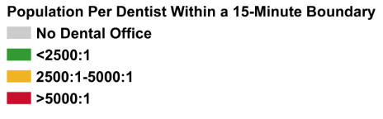
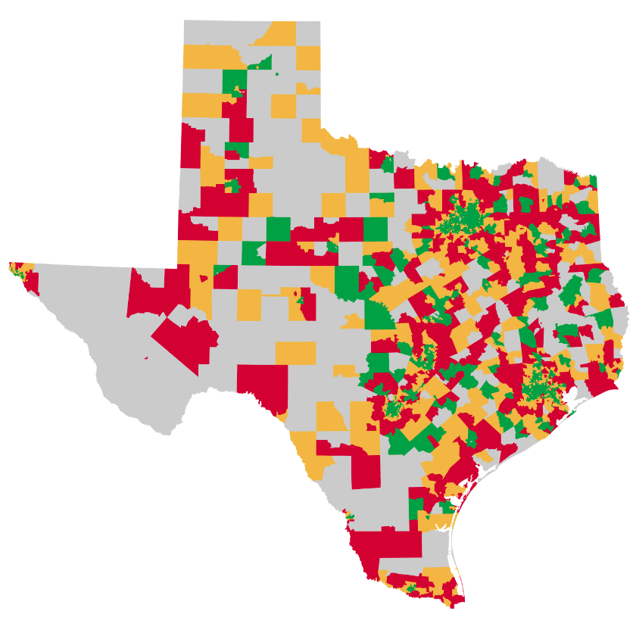
Geographic Access
3% of the population do not have a dentist within a 15 minute travel time
52% of the population live in areas with more than one dentist within a 15 minute travel time for every 2,500 people
31% of the population live in areas with one dentist within a 15 minute travel time for every 2,500 to 5,000 people
14% of the population live in areas with less than one dentist within a 15 minute travel time for every 5,000 people

Slide 20
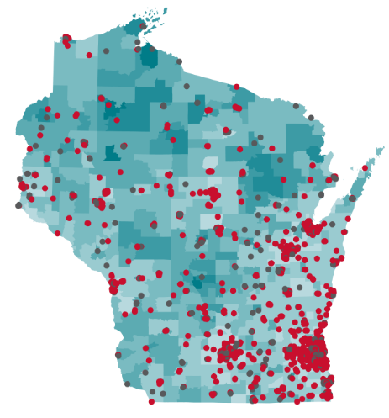
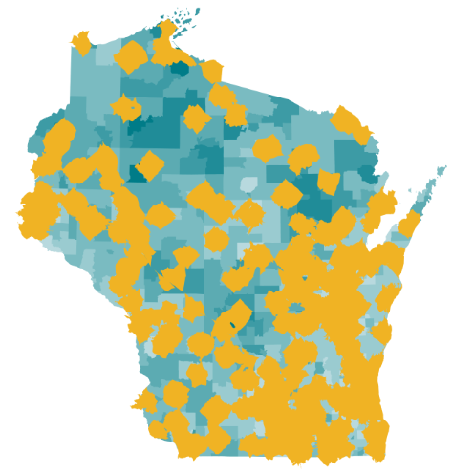
Geographic Access

Slide 21
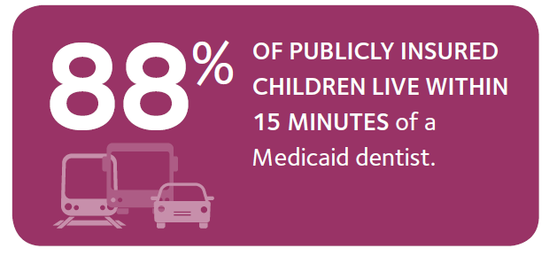
Geographic Access

Slide 22
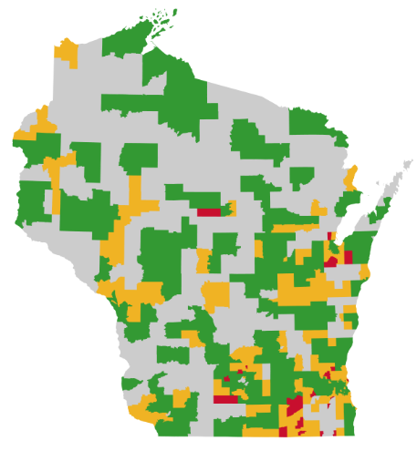
Geographic Access
12% of publicly insured children do not have a Medicaid or CHIP dentist within a 15 minute travel time
58% of publicly insured children live in areas with more than one Medicaid or CHIP dentist within a 15 minute travel time for every 500 publicly insured children
29% of publicly insured children live in areas with one Medicaid or CHIP dentist within a 15 minute travel time for every 500 to 2,000 publicly insured children
1% of publicly insured children live in areas with less than one Medicaid or CHIP dentist within a 15 minute travel time for every 2,000 publicly insured children

Slide 23
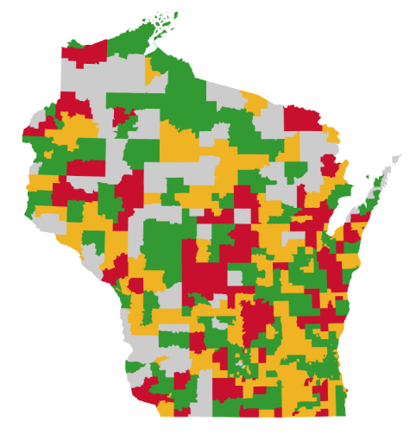
Geographic Access
4% of the population do not have a dentist within a 15 minute travel time
61% of the population live in areas with more than one dentist within a 15 minute travel time for every 2,500 people
26% of the population live in areas with one dentist within a 15 minute travel time for every 2,500 to 5,000 people
9% of the population live in areas with less than one dentist within a 15 minute travel time for every 5,000 people

Slide 24
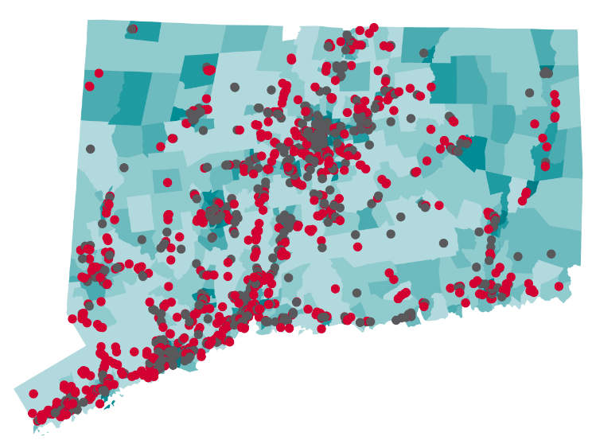
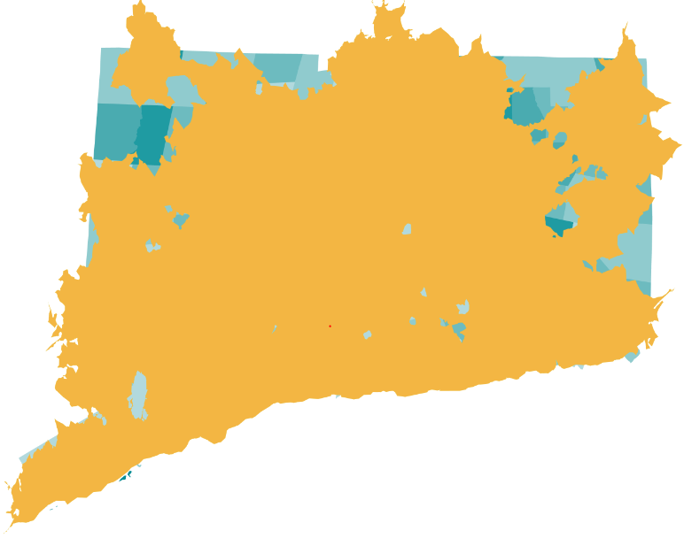
Geographic Access

Slide 25
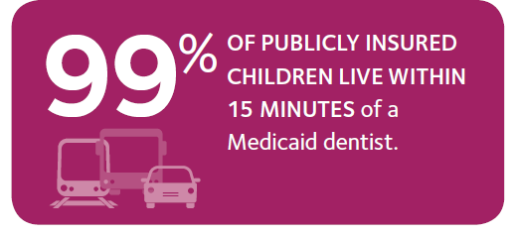
Geographic Access

Slide 26
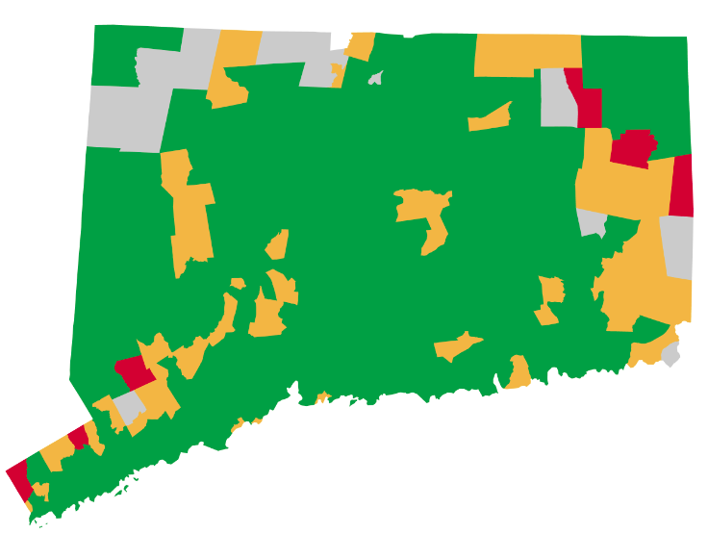
Geographic Access
1% of publicly insured children do not have a Medicaid or CHIP dentist within a 15 minute travel time
95% of publicly insured children live in areas with more than one Medicaid or CHIP dentist within a 15 minute travel time for every 500 publicly insured children
4% of publicly insured children live in areas with one Medicaid or CHIP dentist within a 15 minute travel time for every 500 to 2,000 publicly insured children
0% of publicly insured children live in areas with less than one Medicaid or CHIP dentist within a 15 minute travel time for every 2,000 publicly insured children

Slide 27
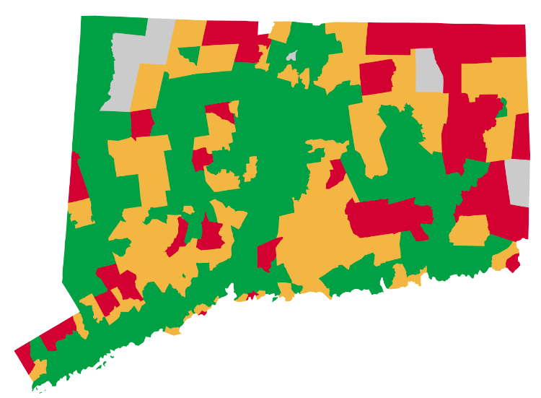
Geographic Access
0% of the population do not have a dentist within a 15 minute travel time
75% of the population live in areas with more than one dentist within a 15 minute travel time for every 2,500 people
19% of the population live in areas with one dentist within a 15 minute travel time for every 2,500 to 5,000 people
6% of the population live in areas with less than one dentist within a 15 minute travel time for every 5,000 people

Slide 28
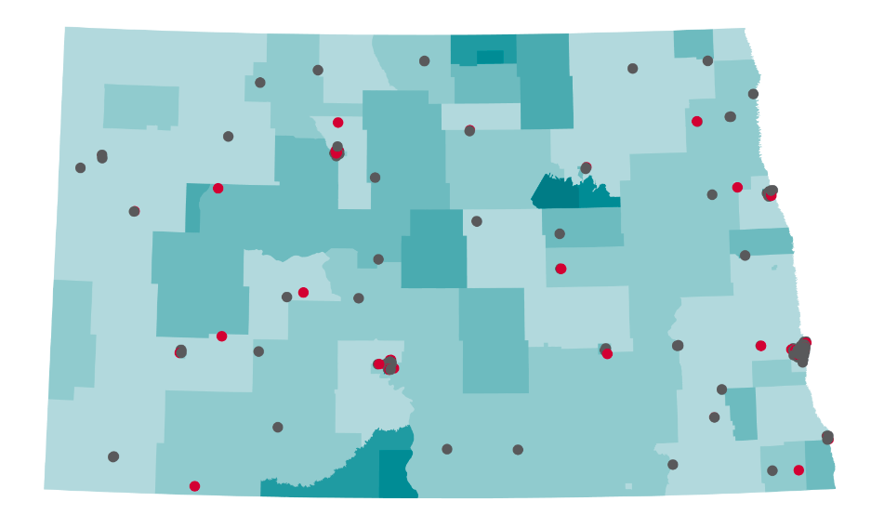
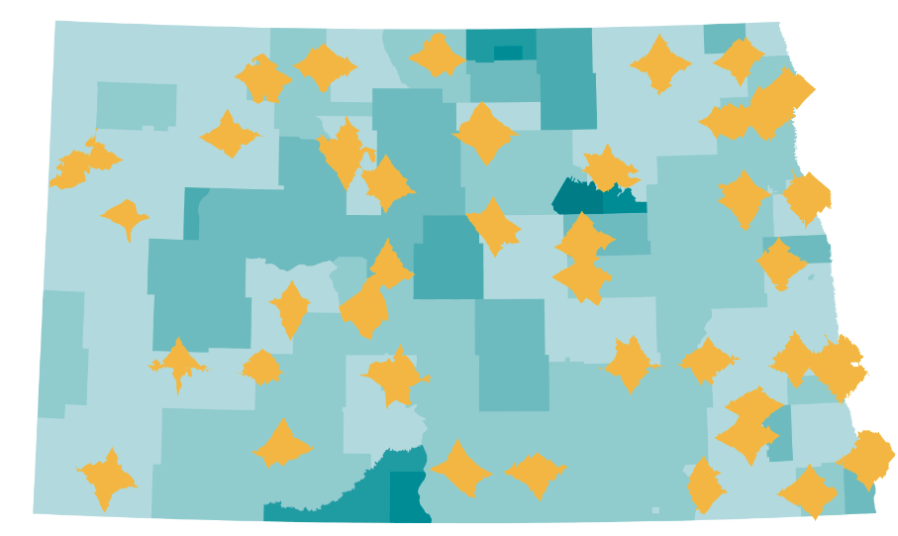
Geographic Access

Slide 29
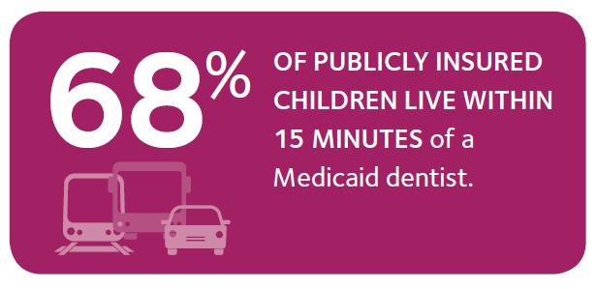
Geographic Access

Slide 30
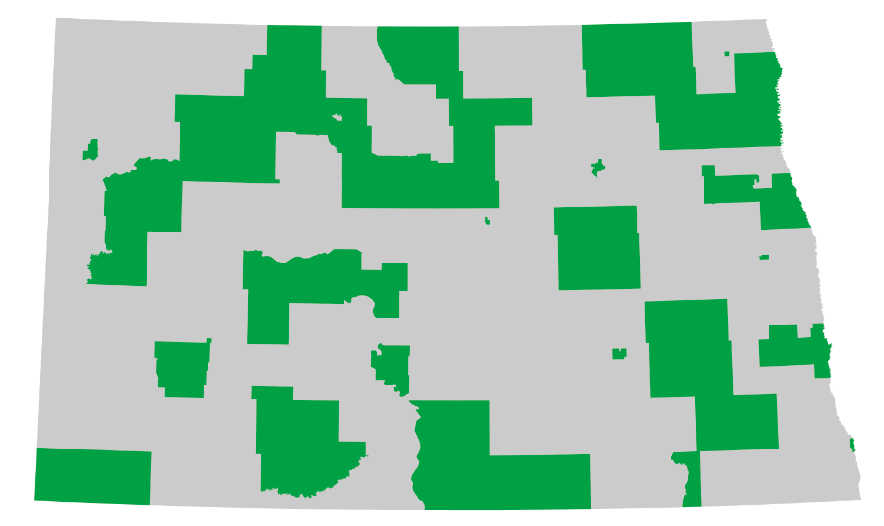
Geographic Access
32% of publicly insured children do not have a Medicaid or CHIP dentist within a 15 minute travel time
68% of publicly insured children live in areas with more than one Medicaid or CHIP dentist within a 15 minute travel time for every 500 publicly insured children
0% of publicly insured children live in areas with one Medicaid or CHIP dentist within a 15 minute travel time for every 500 to 2,000 publicly insured children
0% of publicly insured children live in areas with less than one Medicaid or CHIP dentist within a 15 minute travel time for every 2,000 publicly insured children

Slide 31
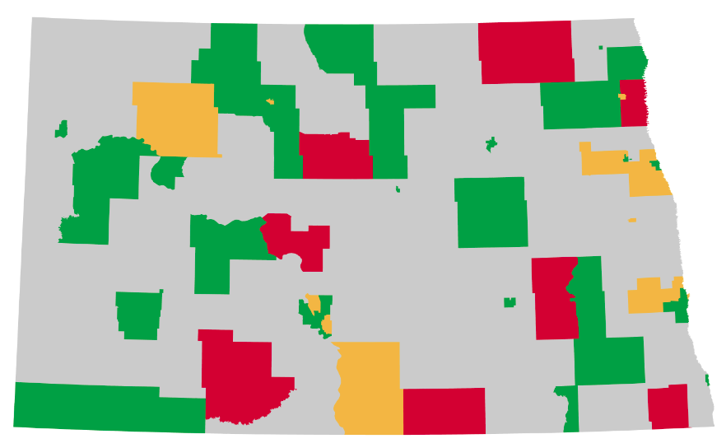
Geographic Access
20% of the population do not have a dentist within a 15 minute travel time
69% of the population live in areas with more than one dentist within a 15 minute travel time for every 2,500 people
8% of the population live in areas with one dentist within a 15 minute travel time for every 2,500 to 5,000 people
3% of the population live in areas with less than one dentist within a 15 minute travel time for every 5,000 people

Slide 32
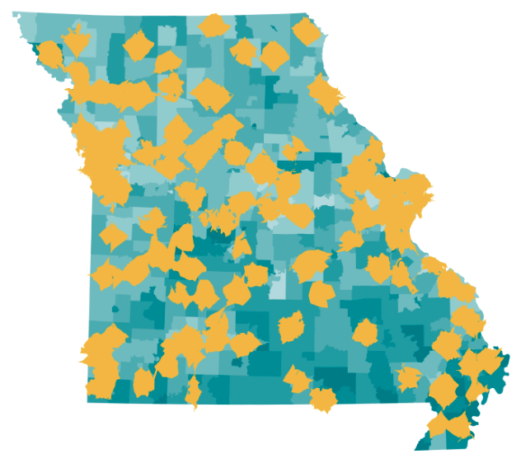







Geographic Access

Slide 33


Released Today!

Slide 34
Using This New Tool

Slide 35
Using This New Tool

Slide 36


Comparing Reimbursement in Medicaid

Slide 37

Using This New Tool

Slide 38

Using This New Tool

Slide 39

Using This New Tool

Slide 40



Next Steps
Access Maps 2.0
  Color the tracts according to dental care utilization among Medicaid enrollees
  Color providers based on alternative definitions of “participate in Medicaid or CHIP”
  Rerun analysis for Medicaid adults
Mystery shopper study to verify that dentists are accepting Medicaid patients
Dentist workforce projections under alternative assumptions
Policy simulations to predict impact of policy reforms on dentist participation in Medicaid

Slide 41

Jayanth Kumar
State Dental Director, California Department of Public Health

Slide 42

Marty Milkovic
Director of Care Coordination & Outreach, Connecticut Dental Health Partnership

Slide 43
Roundtable
Marko Vujicic, PhD
Chief Economist & Vice President, ADA Health Policy Institute
Jayanth Kumar, DDS, MPH
State Dental Director, California Department of Public Health
Marty Milkovic, MSW
Director of Care Coordination & Outreach, Connecticut Dental Health Partnership

Slide 44


Thank You!
@ADAHPI
ADA.org/HPI
hpi@ada.org

