Slide 1
Oral Health and Well-Being in the United States
New Data for Policy Makers
Thank you for joining! You will be on hold until the call begins at 11 a.m. Central time
Please remember to mute your phone unless you are speaking.
This webinar will be recorded.
If you are not currently connected by phone, dial 1.888.203.5515
If prompted, enter conference ID: 18147433

Slide 2













The ADA Health Policy Institute

Slide 3
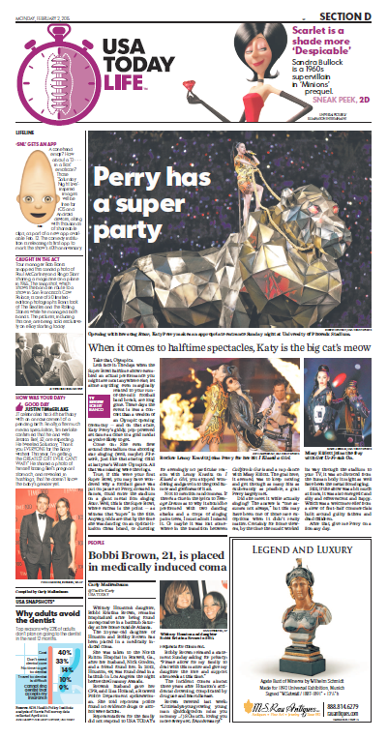
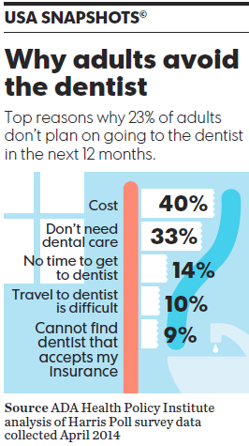
The ADA Health Policy Institute

Slide 4
Today
CHAIR
Marko Vujicic, PhD, Chief Economist & Vice President, Health Policy Institute
PANELISTS
Anne Schwartz, PhD, Executive Director, Medicaid and CHIP Payment and Access Commission (MACPAC)
Rachel Klein, MA, Director of Organizational Strategy, Families USA
Marty Milkovic, MSW, Director, Care Coordination & Outreach, Connecticut Dental Health Partnership (CTDHP)
William Heller, BS, Director, Provider Relations, Dental and NEMT Programs, Colorado Department of Health Care Policy & Financing

Slide 5
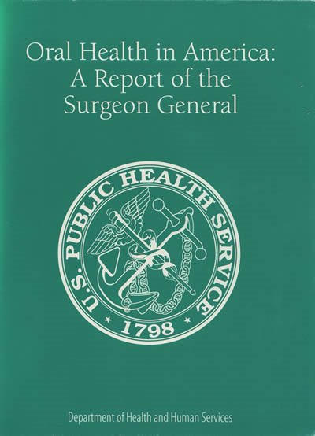
Background
“You can’t be healthy without good oral health.”
C.E. Koop
fmr. U.S. Surgeon General

Slide 6
Background
Comprehensive definitions of oral health have not been operationalized
Large-scale, national data efforts focus mainly on measuring
  Oral diseases
  Dental care use
  Spending
But limited data on oral health’s impact on well-being

Slide 7
A New Resource for Health Policy
HPI’s new Oral Health and Well-Being Survey
Measures how the condition of mouth and teeth impact physical, social, emotional, and economic well-being of adults in the U.S.
  Reviewed existing oral health quality of life instruments
  Simplified!
  Input from global experts
Data collection
  Harris Poll collect data for HPI in 2015
  Sampling strategy allows reporting by state, by income level
  Multiple phases: focus group, pre-pilot, pilot, full roll out
  Final sample of nearly 15,000 adults
Meant to be a starting point for others to build on

Slide 8
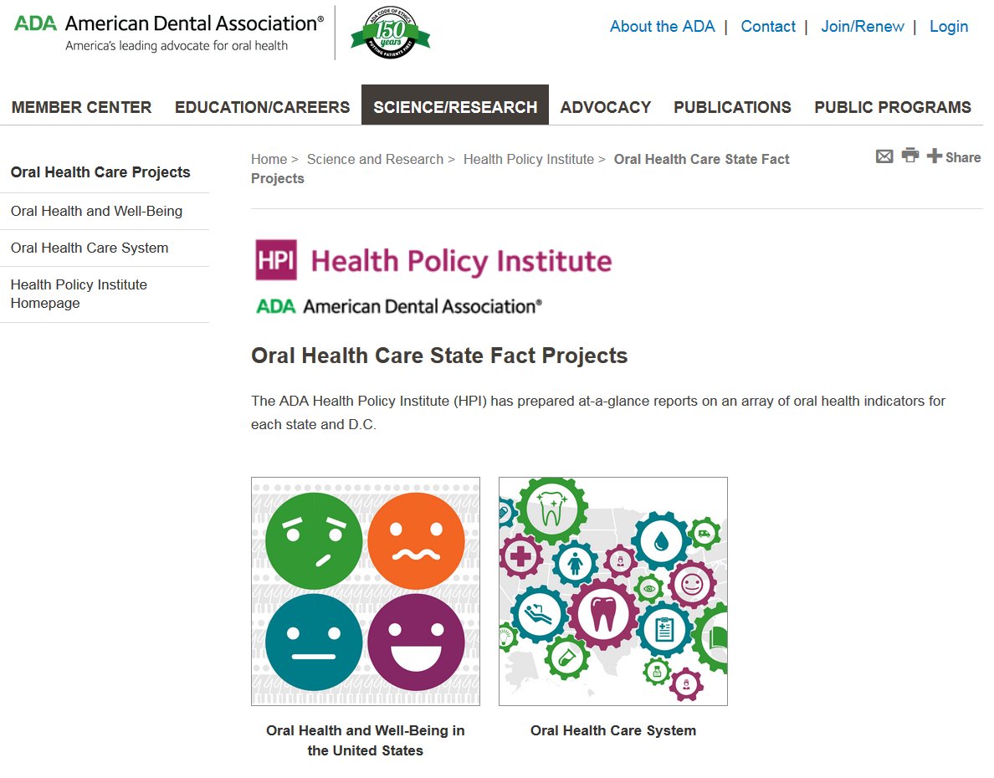
A New Resource for Health Policy
ada.org/statefacts

Slide 9
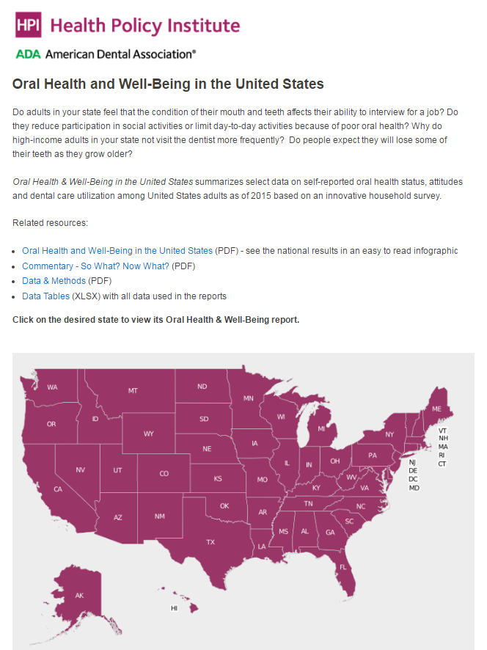
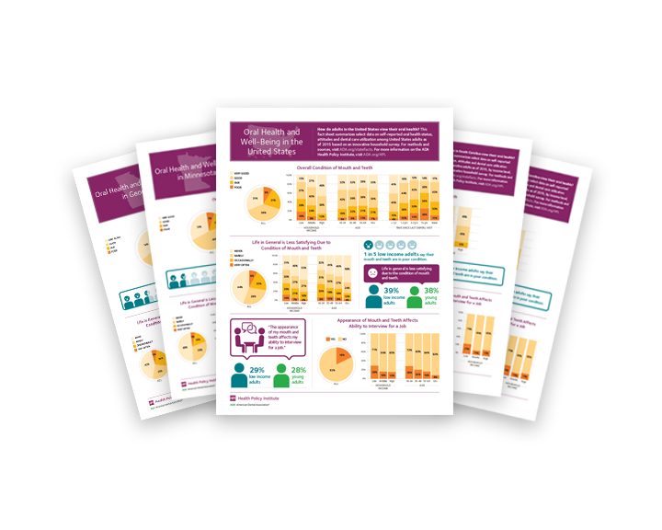
A New Resource for Health Policy

Slide 10
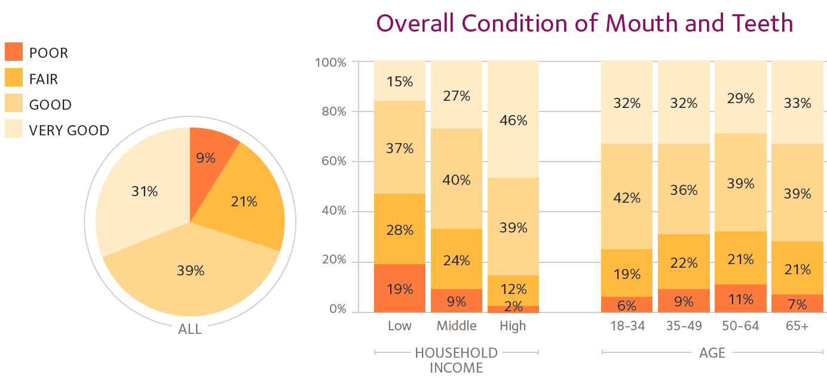
Highlights

Slide 11
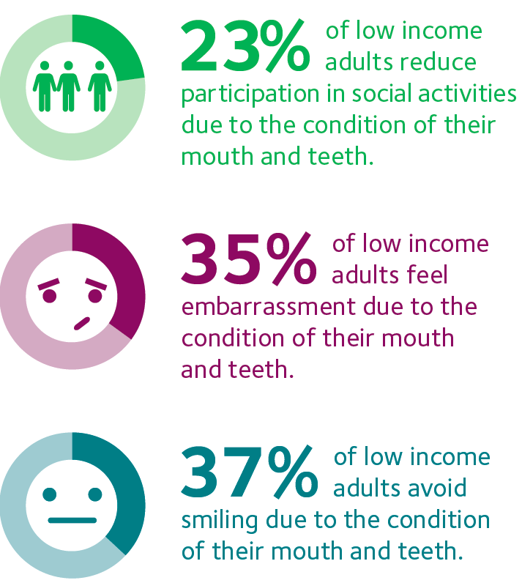
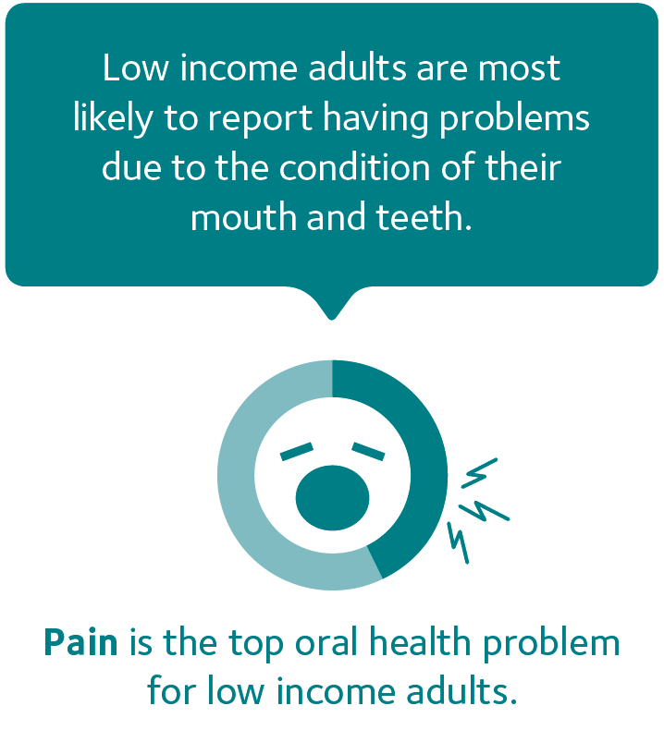
Highlights

Slide 12
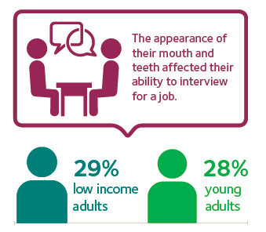
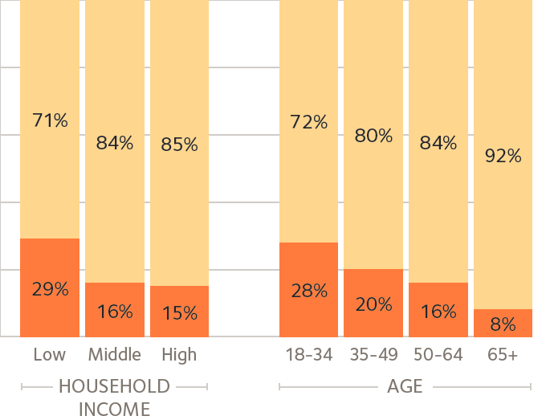
Highlights

Slide 13
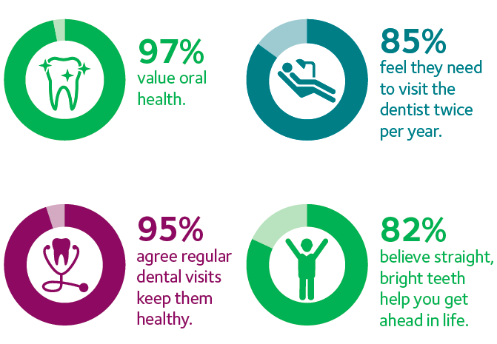
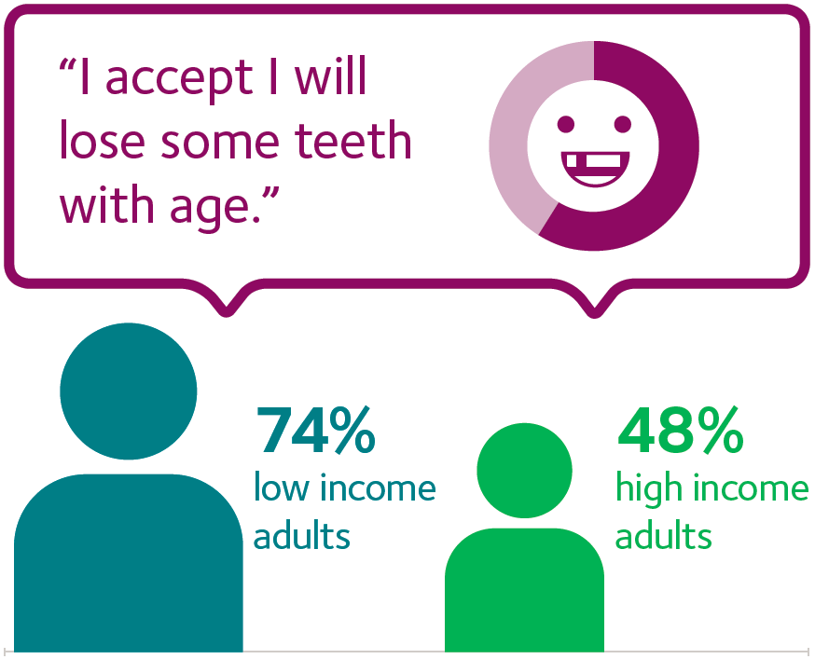
Highlights

Slide 14
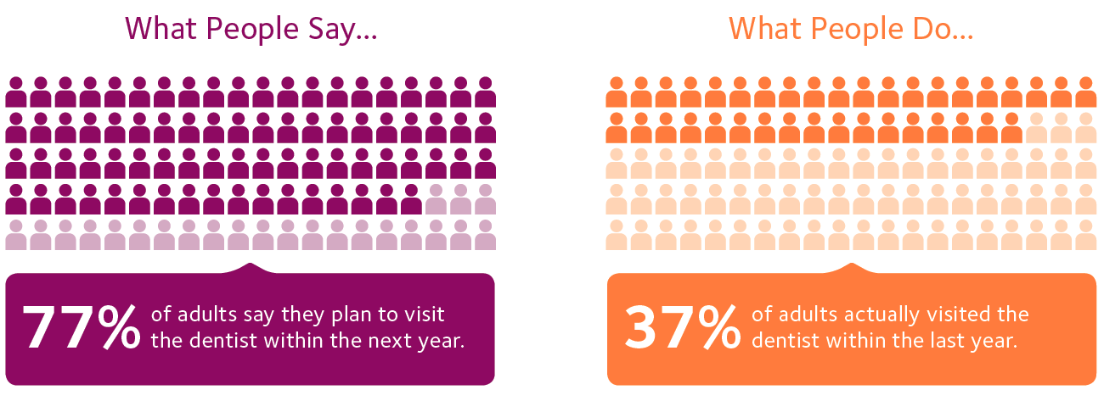
Highlights

Slide 15
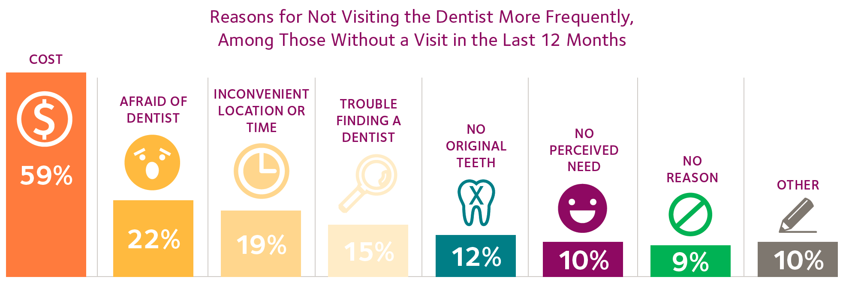
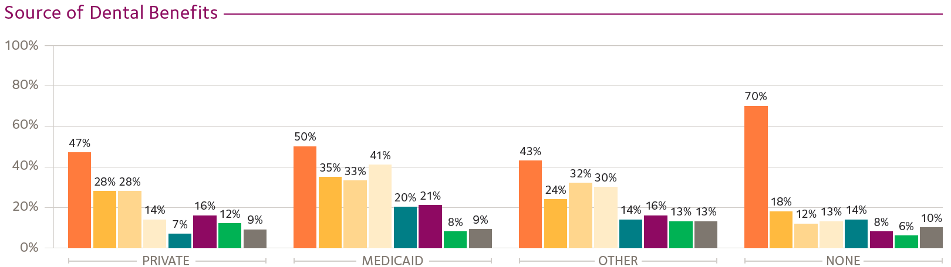
Highlights

Slide 16
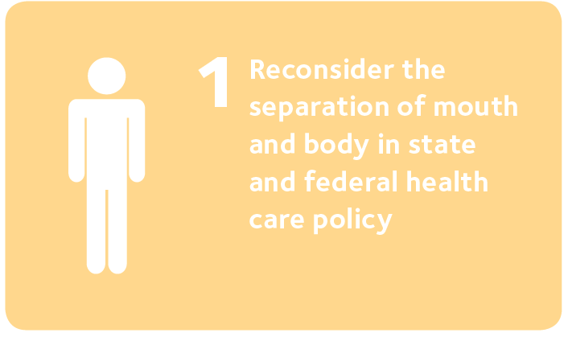
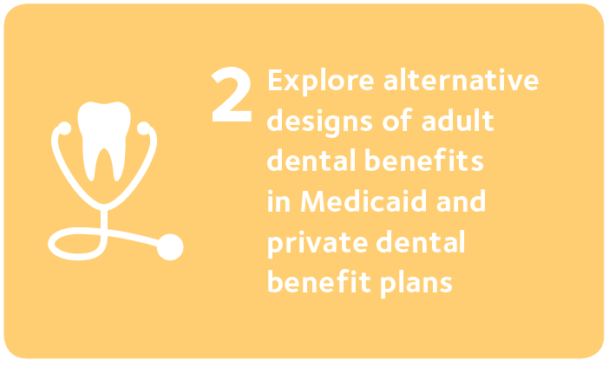
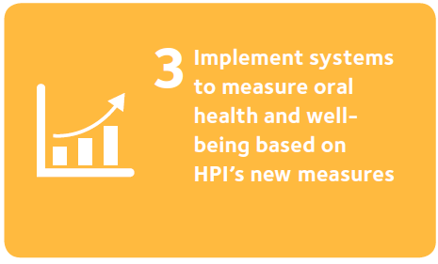
So What? Now What?

Slide 17
Anne Schwartz
Executive Director,
Medicaid and CHIP Payment and Access Commission (MACPAC)

Slide 18
Rachel Klein
Director, Organizational Strategies,
Families USA

Slide 19
Marty Milkovic
Director, Care Coordination & Outreach, Connecticut Dental Health Partnership (CTDHP)

Slide 20
William Heller
Director, Provider Relations, Dental and NEMT Programs, Colorado Department of Health Care Policy & Financing

Slide 21
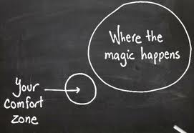

Thank You!
For more information on the Health Policy Institute please visit:
ada.org/hpi
To inquire about speaking engagements or custom data analytics please contact:
hpi@ada.org

Slide 22
Additional Materials from Panelists
New issue brief: Medicaid Access in Brief: Children's Dental Services
https://www.macpac.gov/publication/access-in-brief-childrens-dental-services/
Coverage of Medicaid Dental Benefits for Adults (chapter from June 2015 report to Congress)
https://www.macpac.gov/publication/coverage-of-medicaid-dental-benefits-for-adults-3/
Discussion of dental benefits in CHIP compared to exchange coverage (part of chapter from March 2015 report to Congress)
https://www.macpac.gov/publication/comparing-chip-benefits-to-medicaid-exchange-plans-and-employer-sponsored-insurance-2/
Caring for Colorado Smiles Dental Project
http://www.caringforcolorado.org/smiles-dental-project

